Slide 1
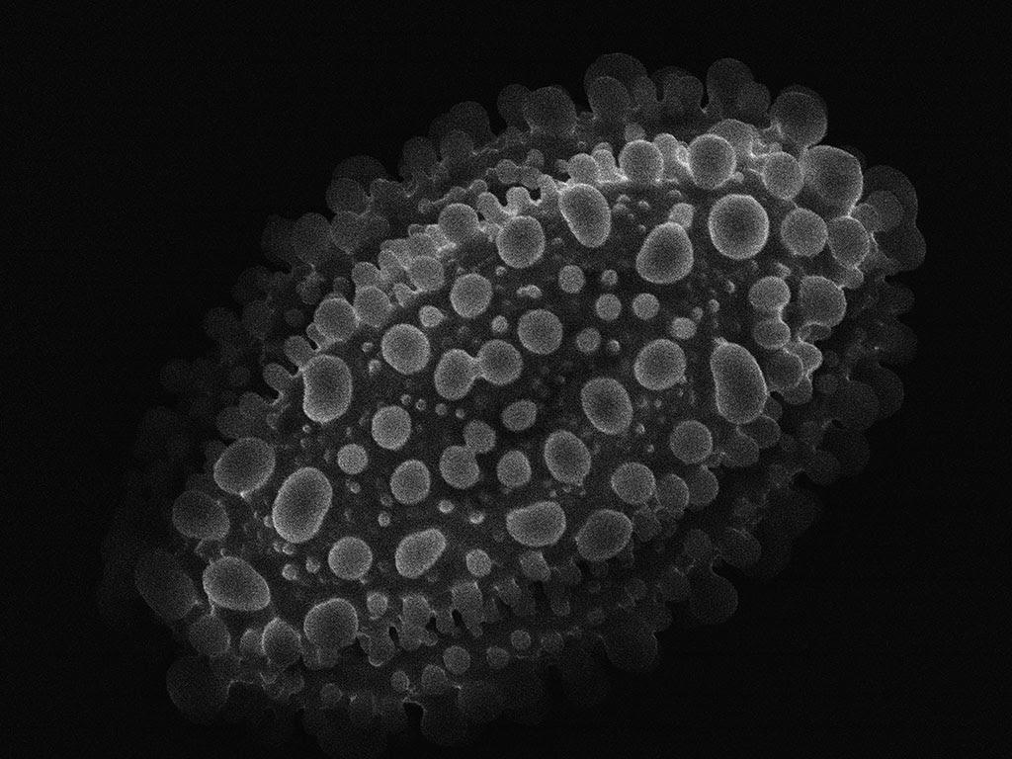
Nanofabrication at Home
10µm
pollen x2300
Rob Flickenger
hackerfriendly.com

Slide 2
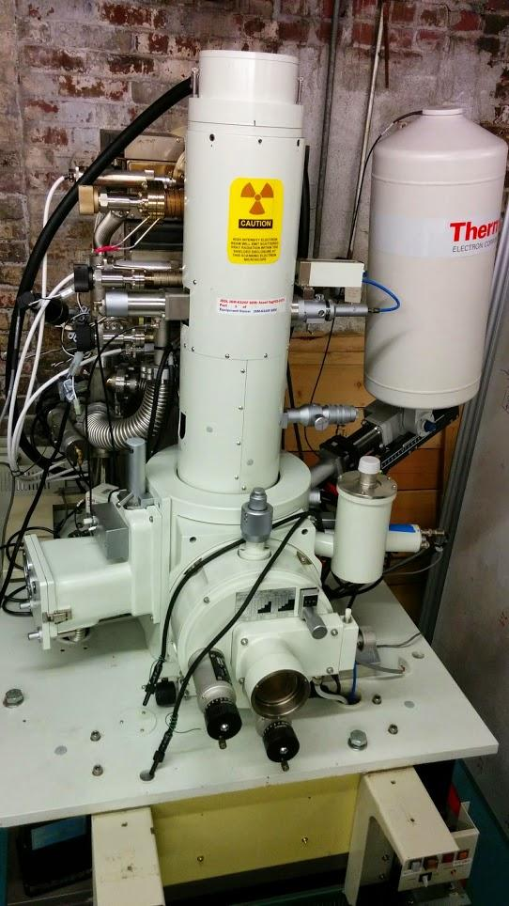
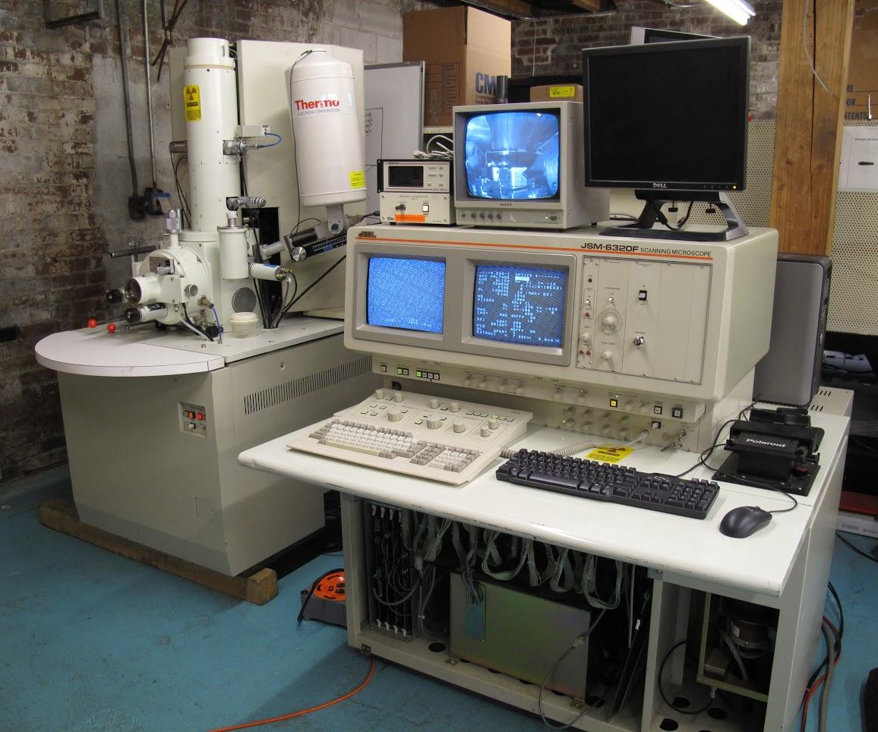
Milly is a JEOL JSM-6320F
Scanning Electron Microscope
Made in 1980

Slide 3
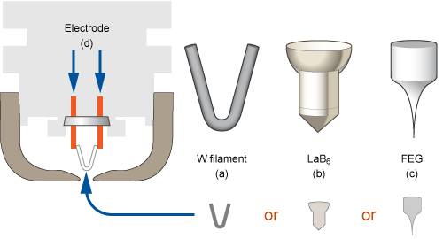
F is for FEG: Field-emission Electron Gun
Cold cathode tungsten crystal
Notes:
Thermionic tungsten vs. lanthanum hexaboride vs. FEG tungsten

Slide 4
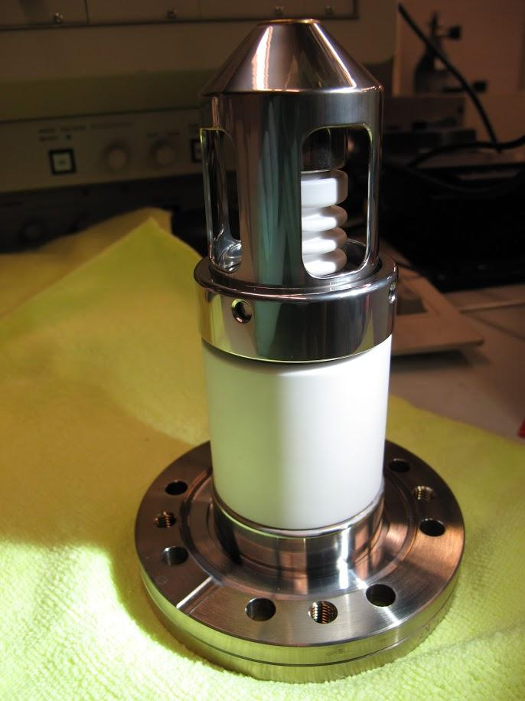
Notes:
Milly’s FEG module. The emitter is under the smooth anode (similar to a Wenhelt in thermionic emitters).

Slide 5
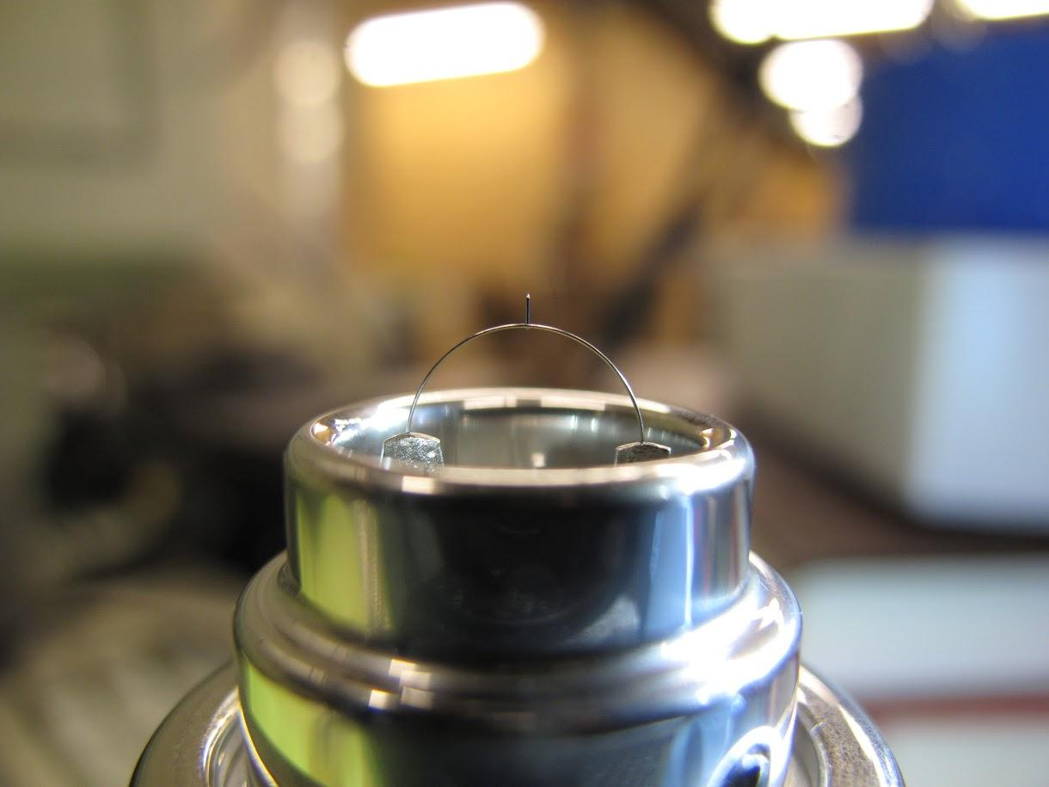
Notes:
The broken emitter.

Slide 6
1mm
0.1mm
8mm
Notes:
8mm tungsten loop, 0.1mm thick

Slide 7
0.0000005mm
(~500 picometers)
1mm
0.1mm
8mm
Notes:
8mm tungsten loop, 0.1mm thick

Slide 8
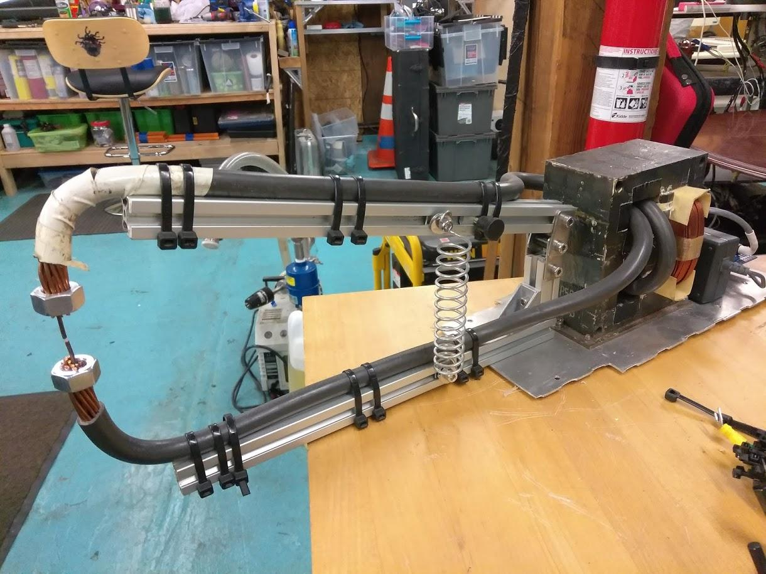

Slide 9
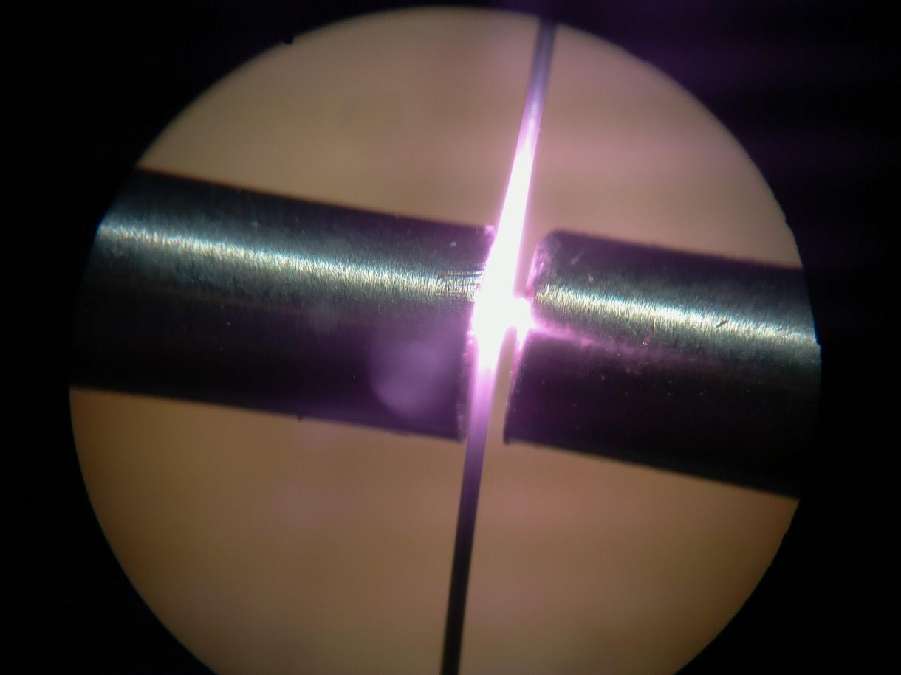

Slide 10
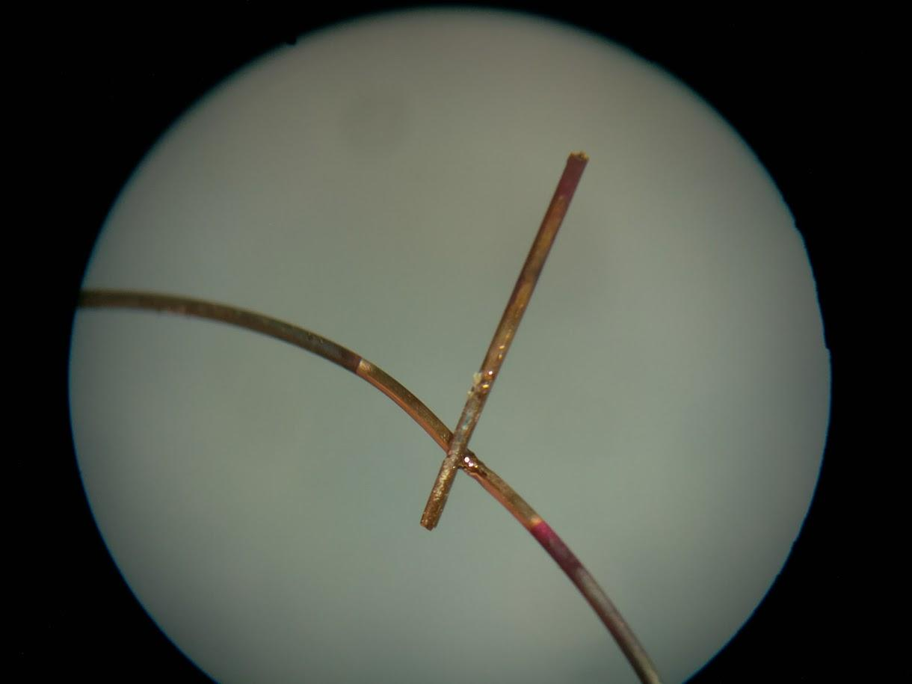

Slide 11
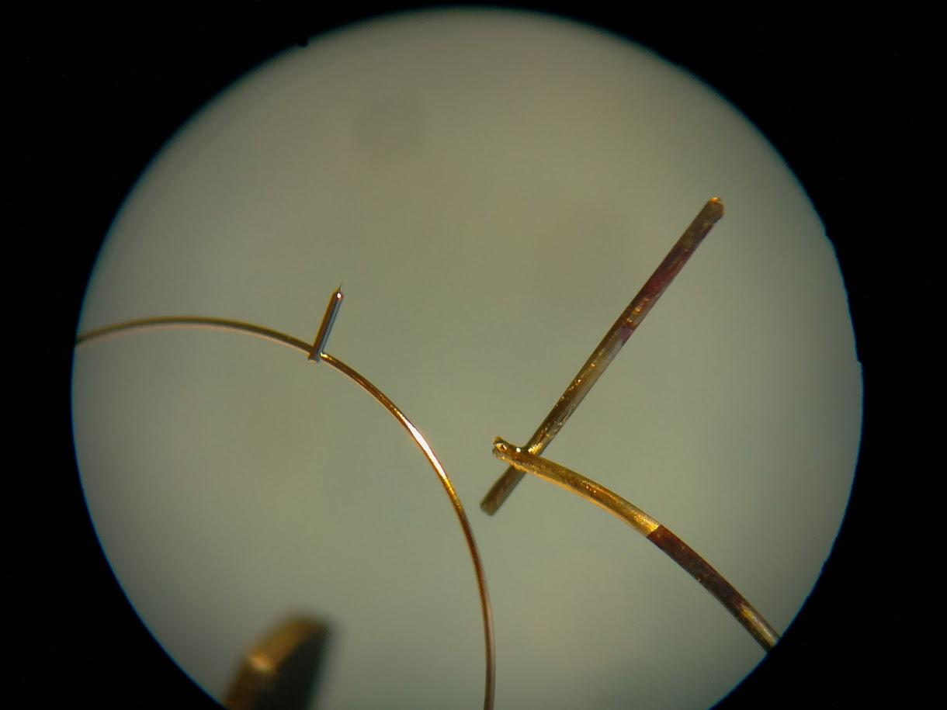
0.1mm
0.25mm

Slide 12
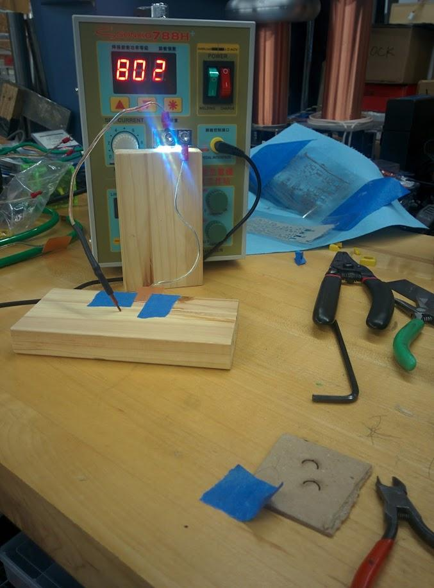
eBay to the rescue
Thanks, drone enthusiasts!
“Battery tab” welder
Much faster rise time
Better current control
< $200 on eBay
Only had to take it apart once (so far) for repair

Slide 13
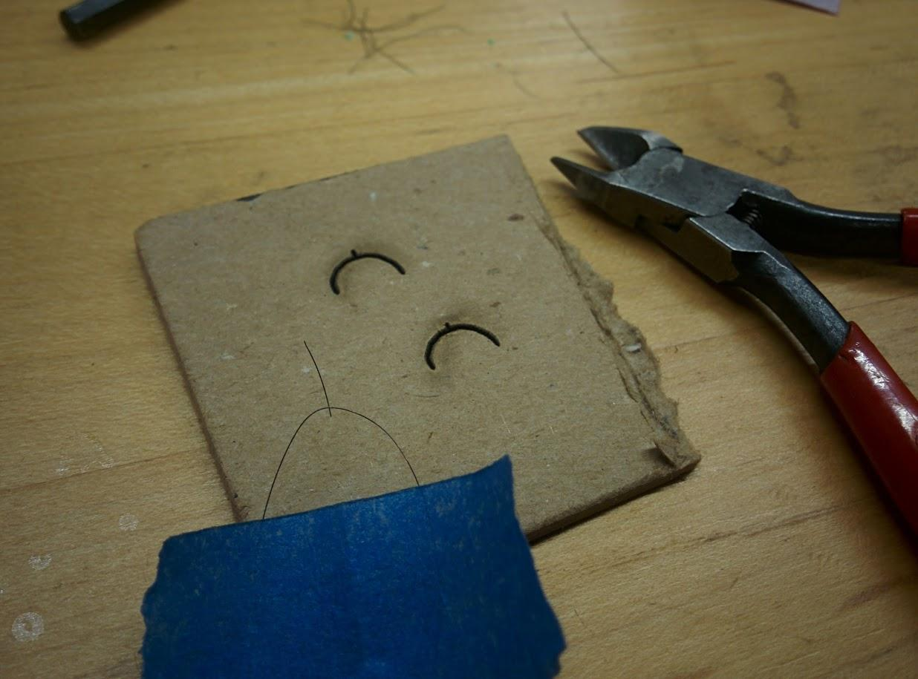

Slide 14
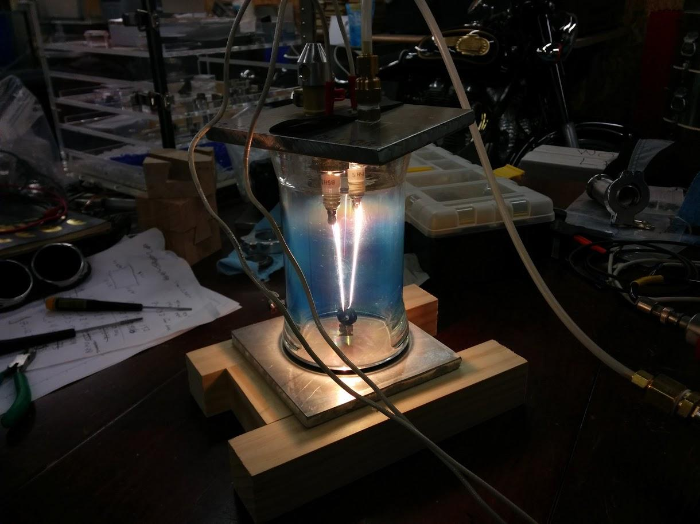
Recrystallizing tungsten wire
http://www.surfacesciencenetwork.com/wiki/index.php?title=Tungsten_wire_recrystallization
Notes:
Recrystallizing polycrystalline tungsten wire in a vacuum chamber. Non-resistive spark plugs make great electrical passthroughs. A variac controls the power.

Slide 15
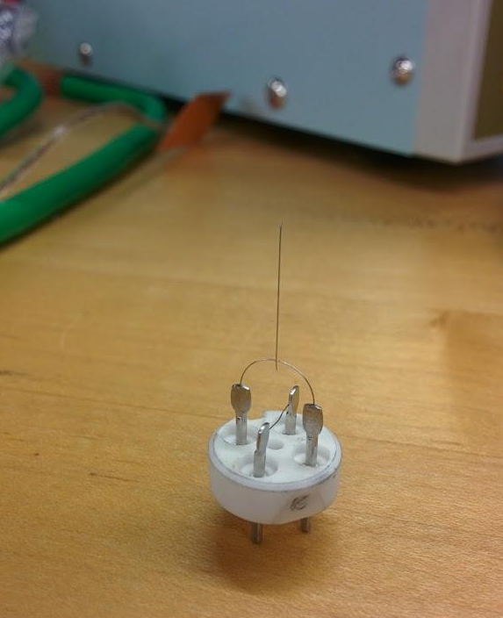
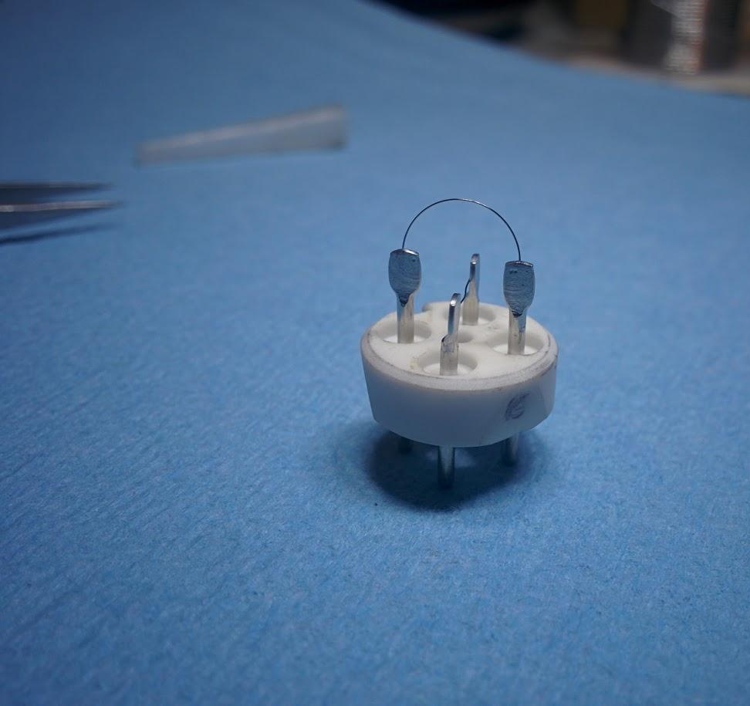
Welded!

Slide 16
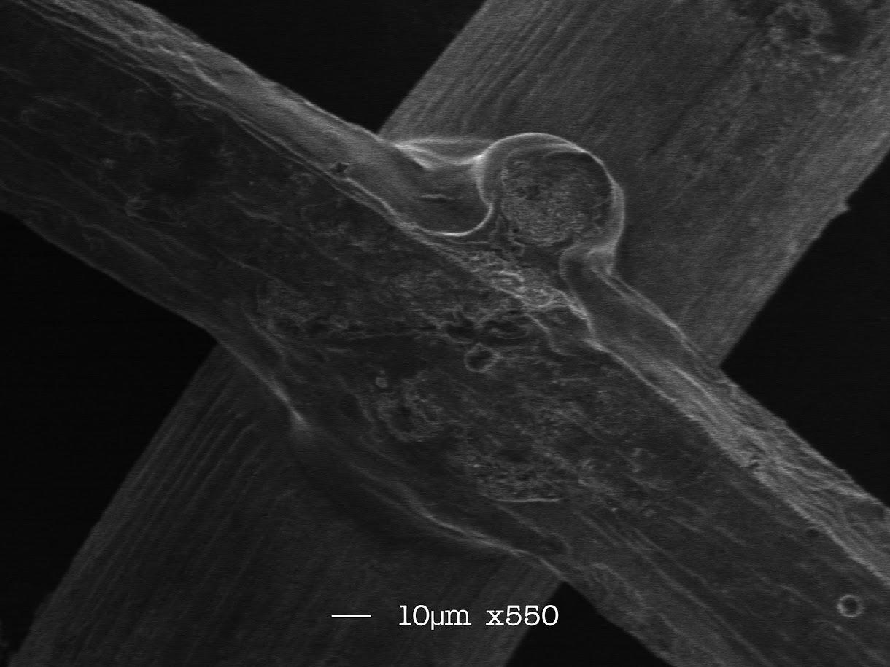
Notes:
SEM image of a test weld. Polycrystalline tungsten wire is in the rear.

Slide 17
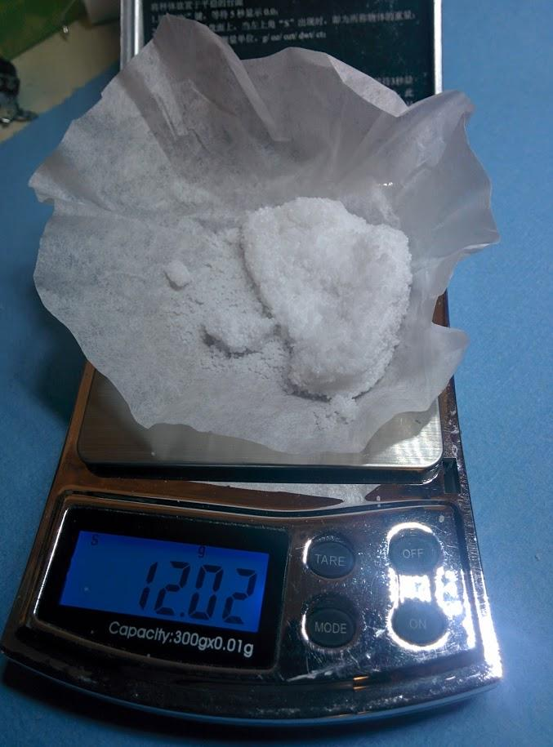
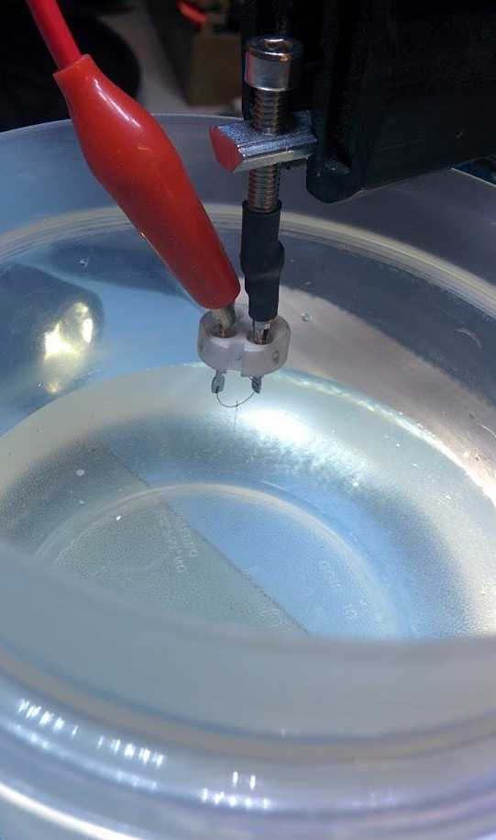
3 molar NaOH solution
Tip will preferentially etch at the meniscus

Slide 18
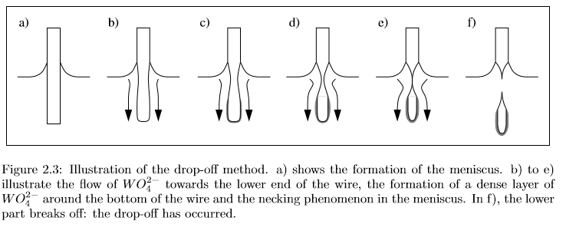
The drop-off method
Anne-Sophie Lucier, thesis for McGill University, February 2004
http://www.physics.mcgill.ca/~peter/theses/lucier.pdf

Slide 19
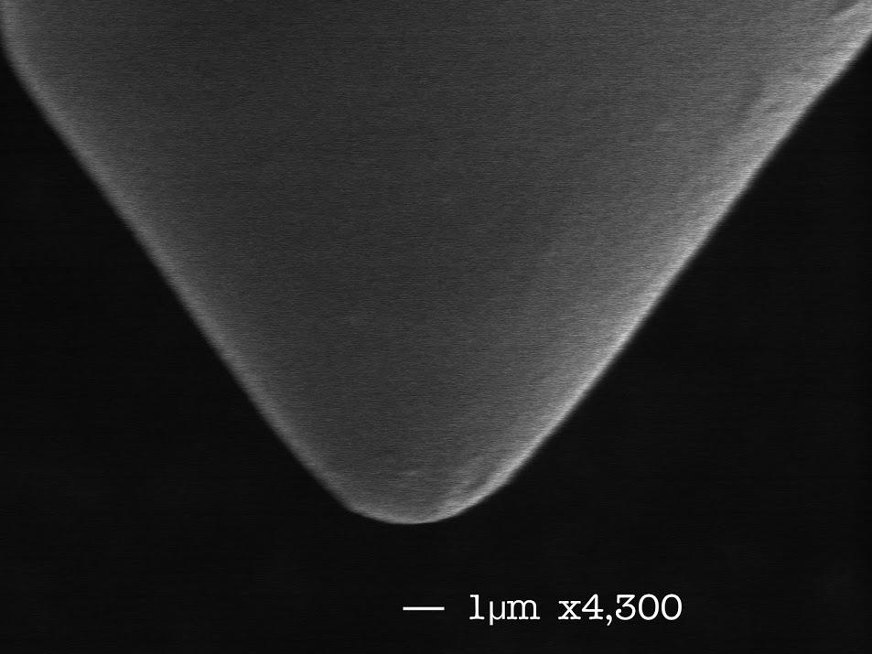
Notes:
The current was switched off far too slow.

Slide 20
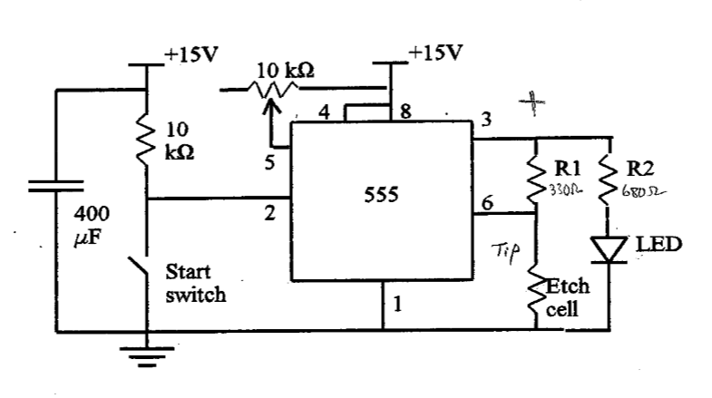
Switch off the current as quickly as possible
Michael C. Robinson, thesis for Queen’s University, July 2000
https://doi.org/10.1142/S0218625X99000810

Slide 21
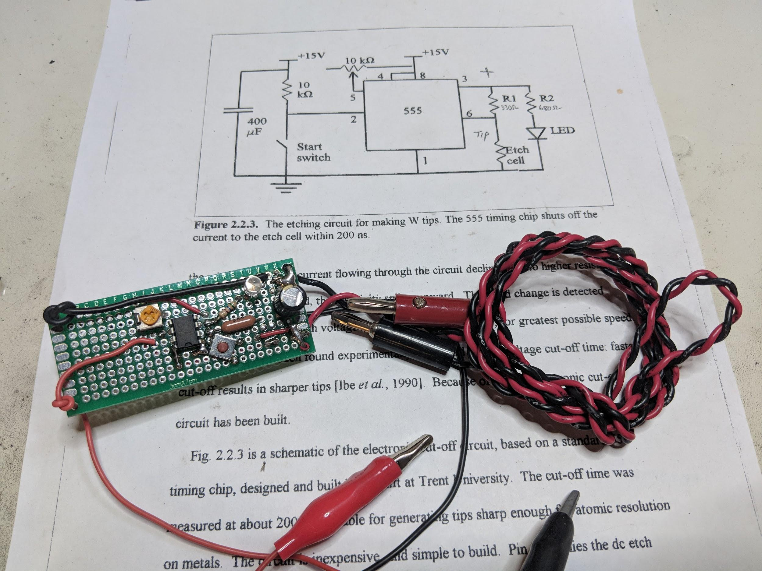

Slide 22
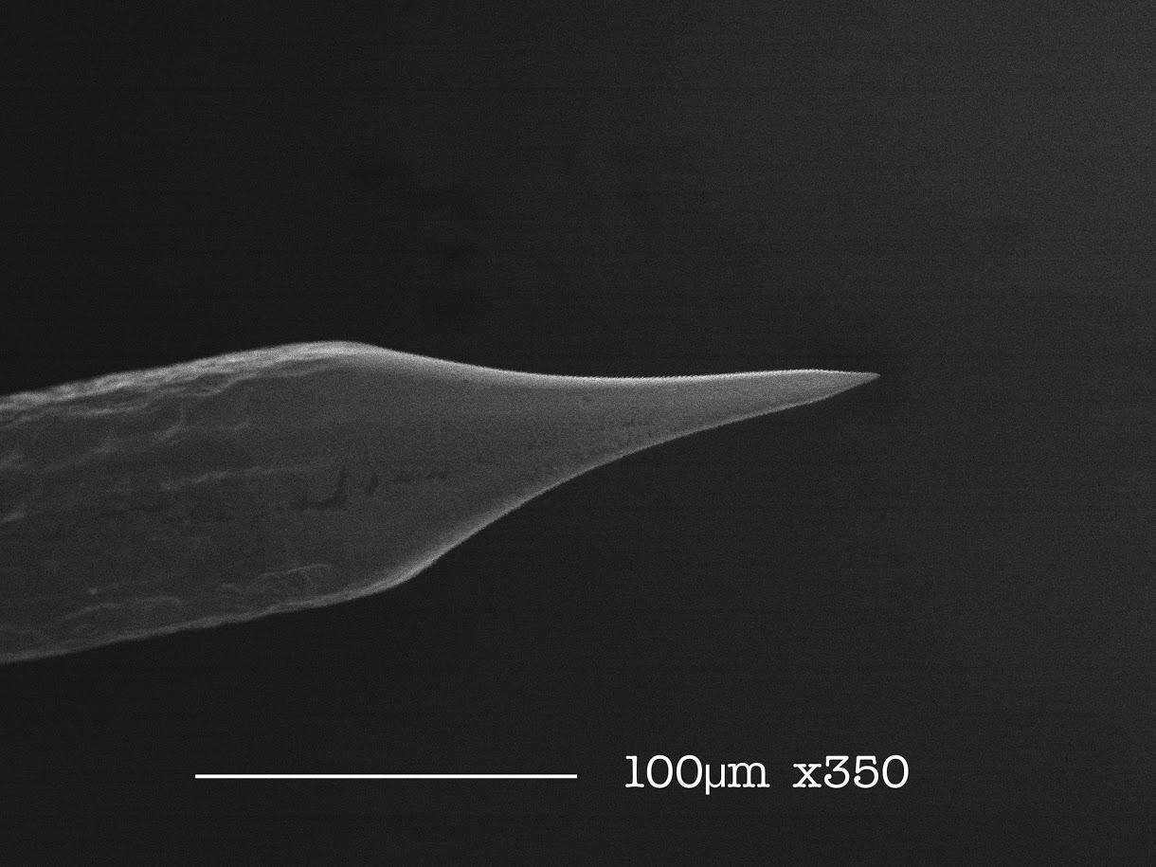

Slide 23
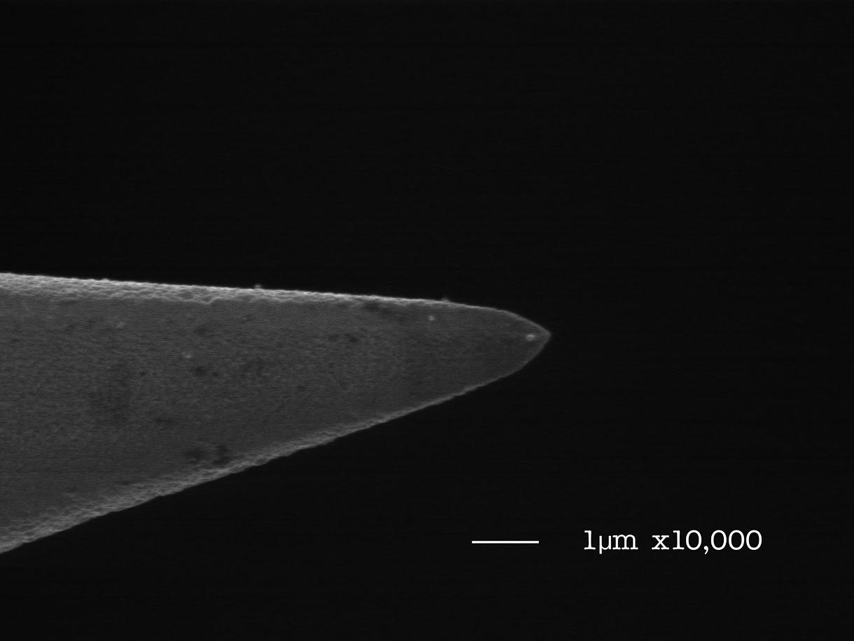

Slide 24
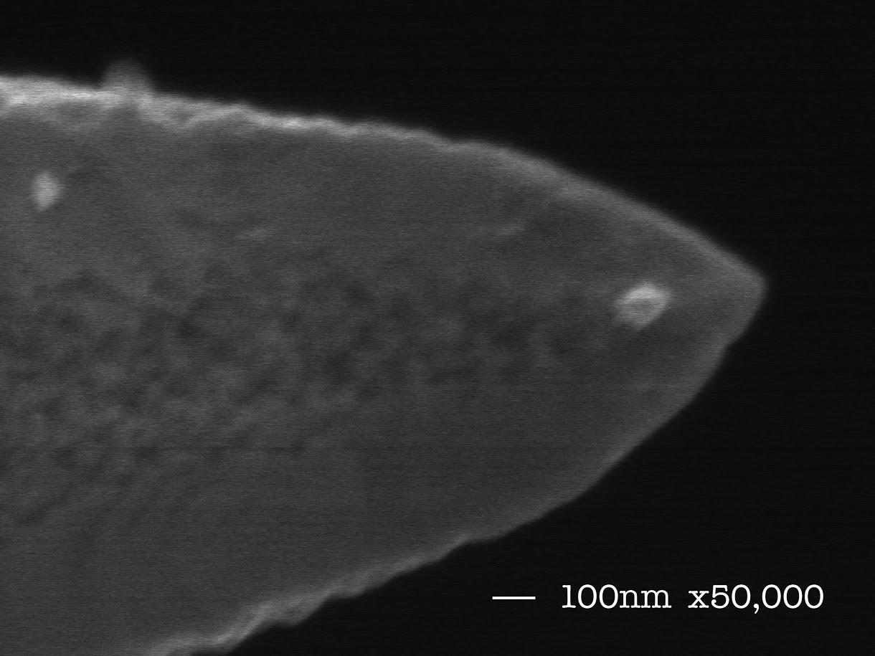

Slide 25
48 hours later...

Slide 26
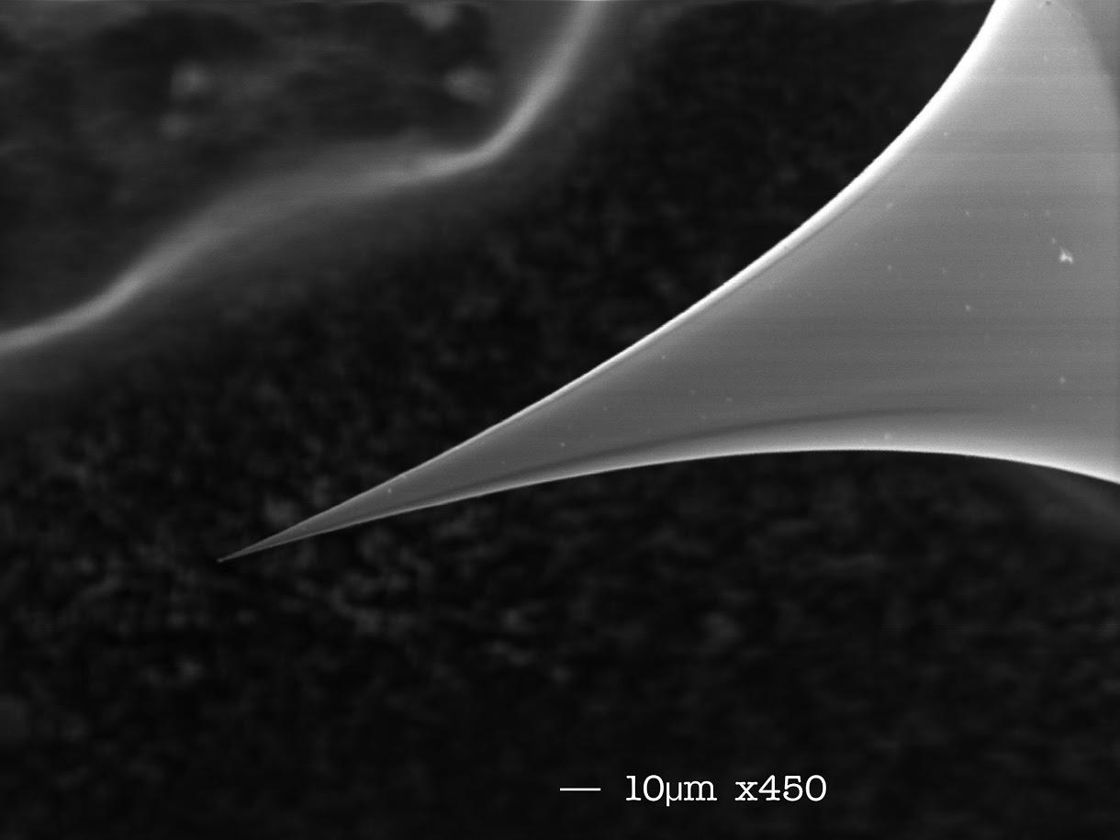
Notes:
The original broken tip.

Slide 27
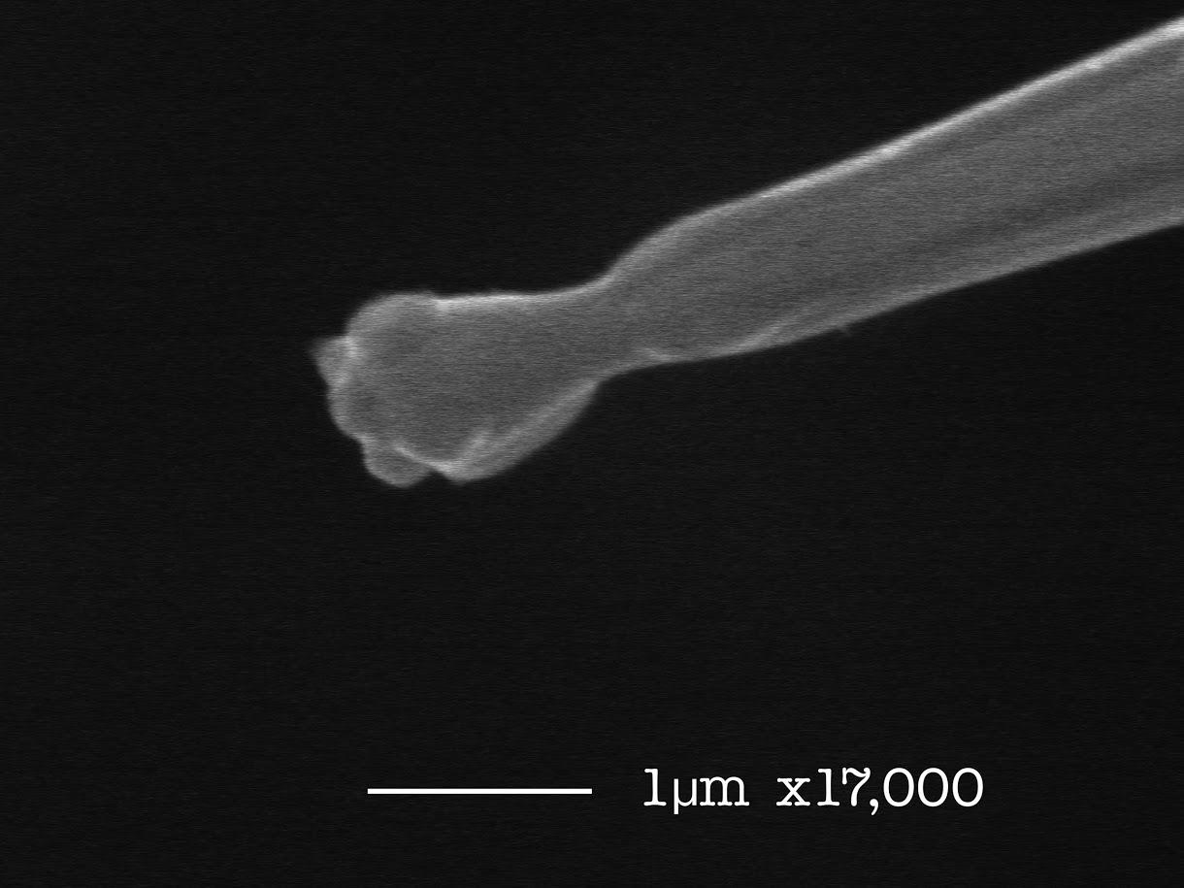
Notes:
Tungsten migrated and combined with random scope junk to make this bullfrog.

Slide 28
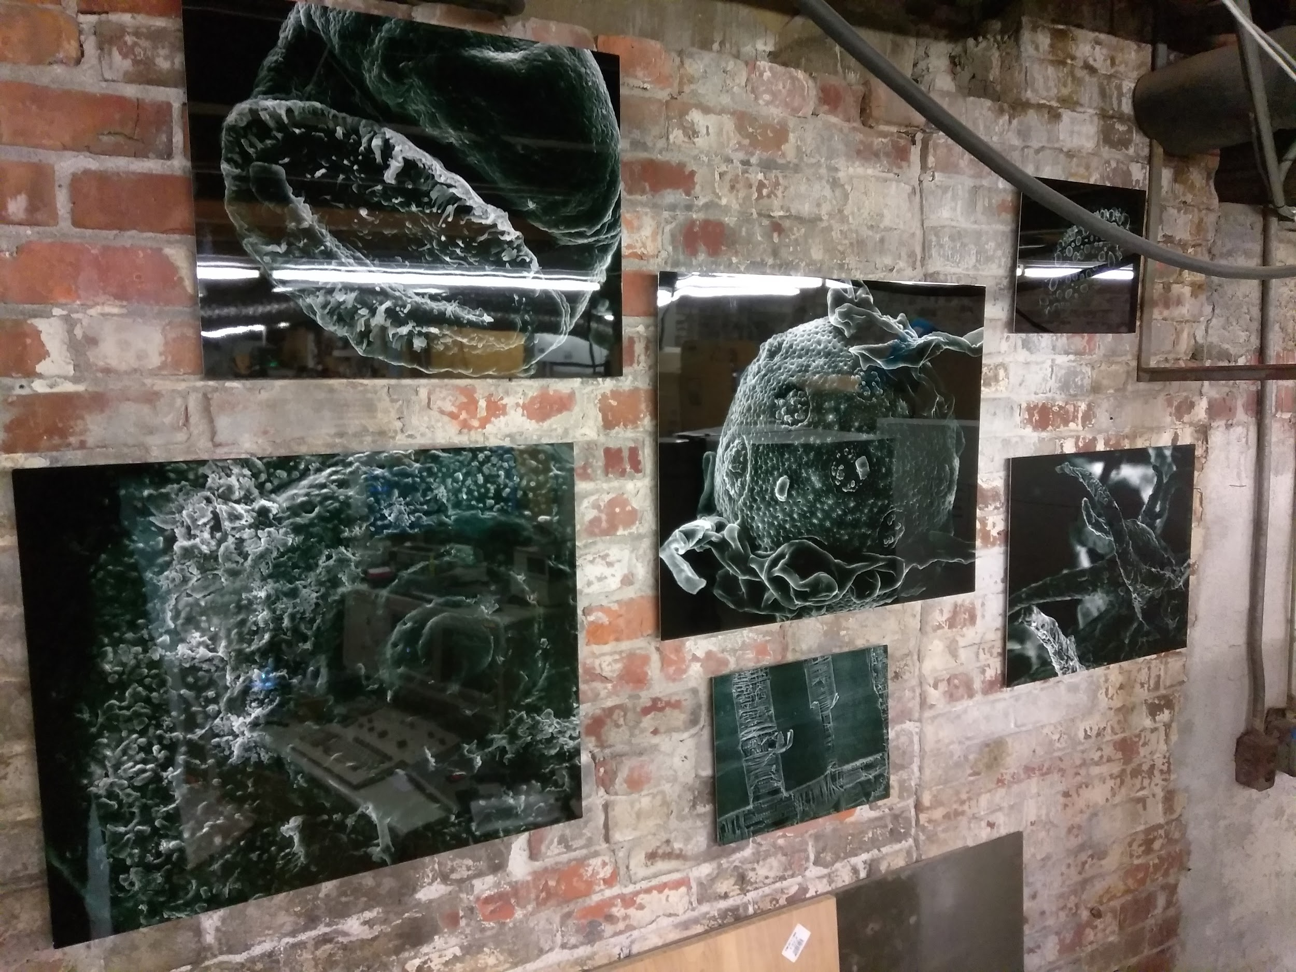
Gallery of tiny things
Notes:
Gold on carbon, x22,000

Slide 29
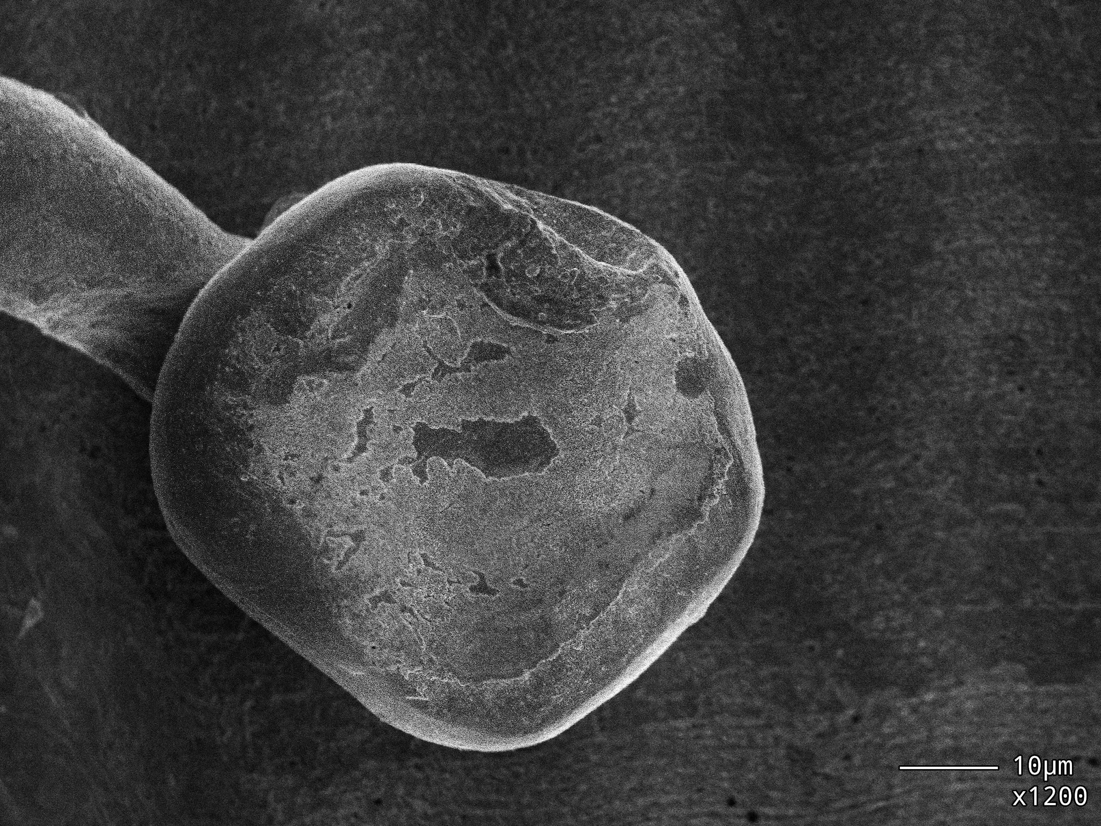
Yubikey

Slide 30
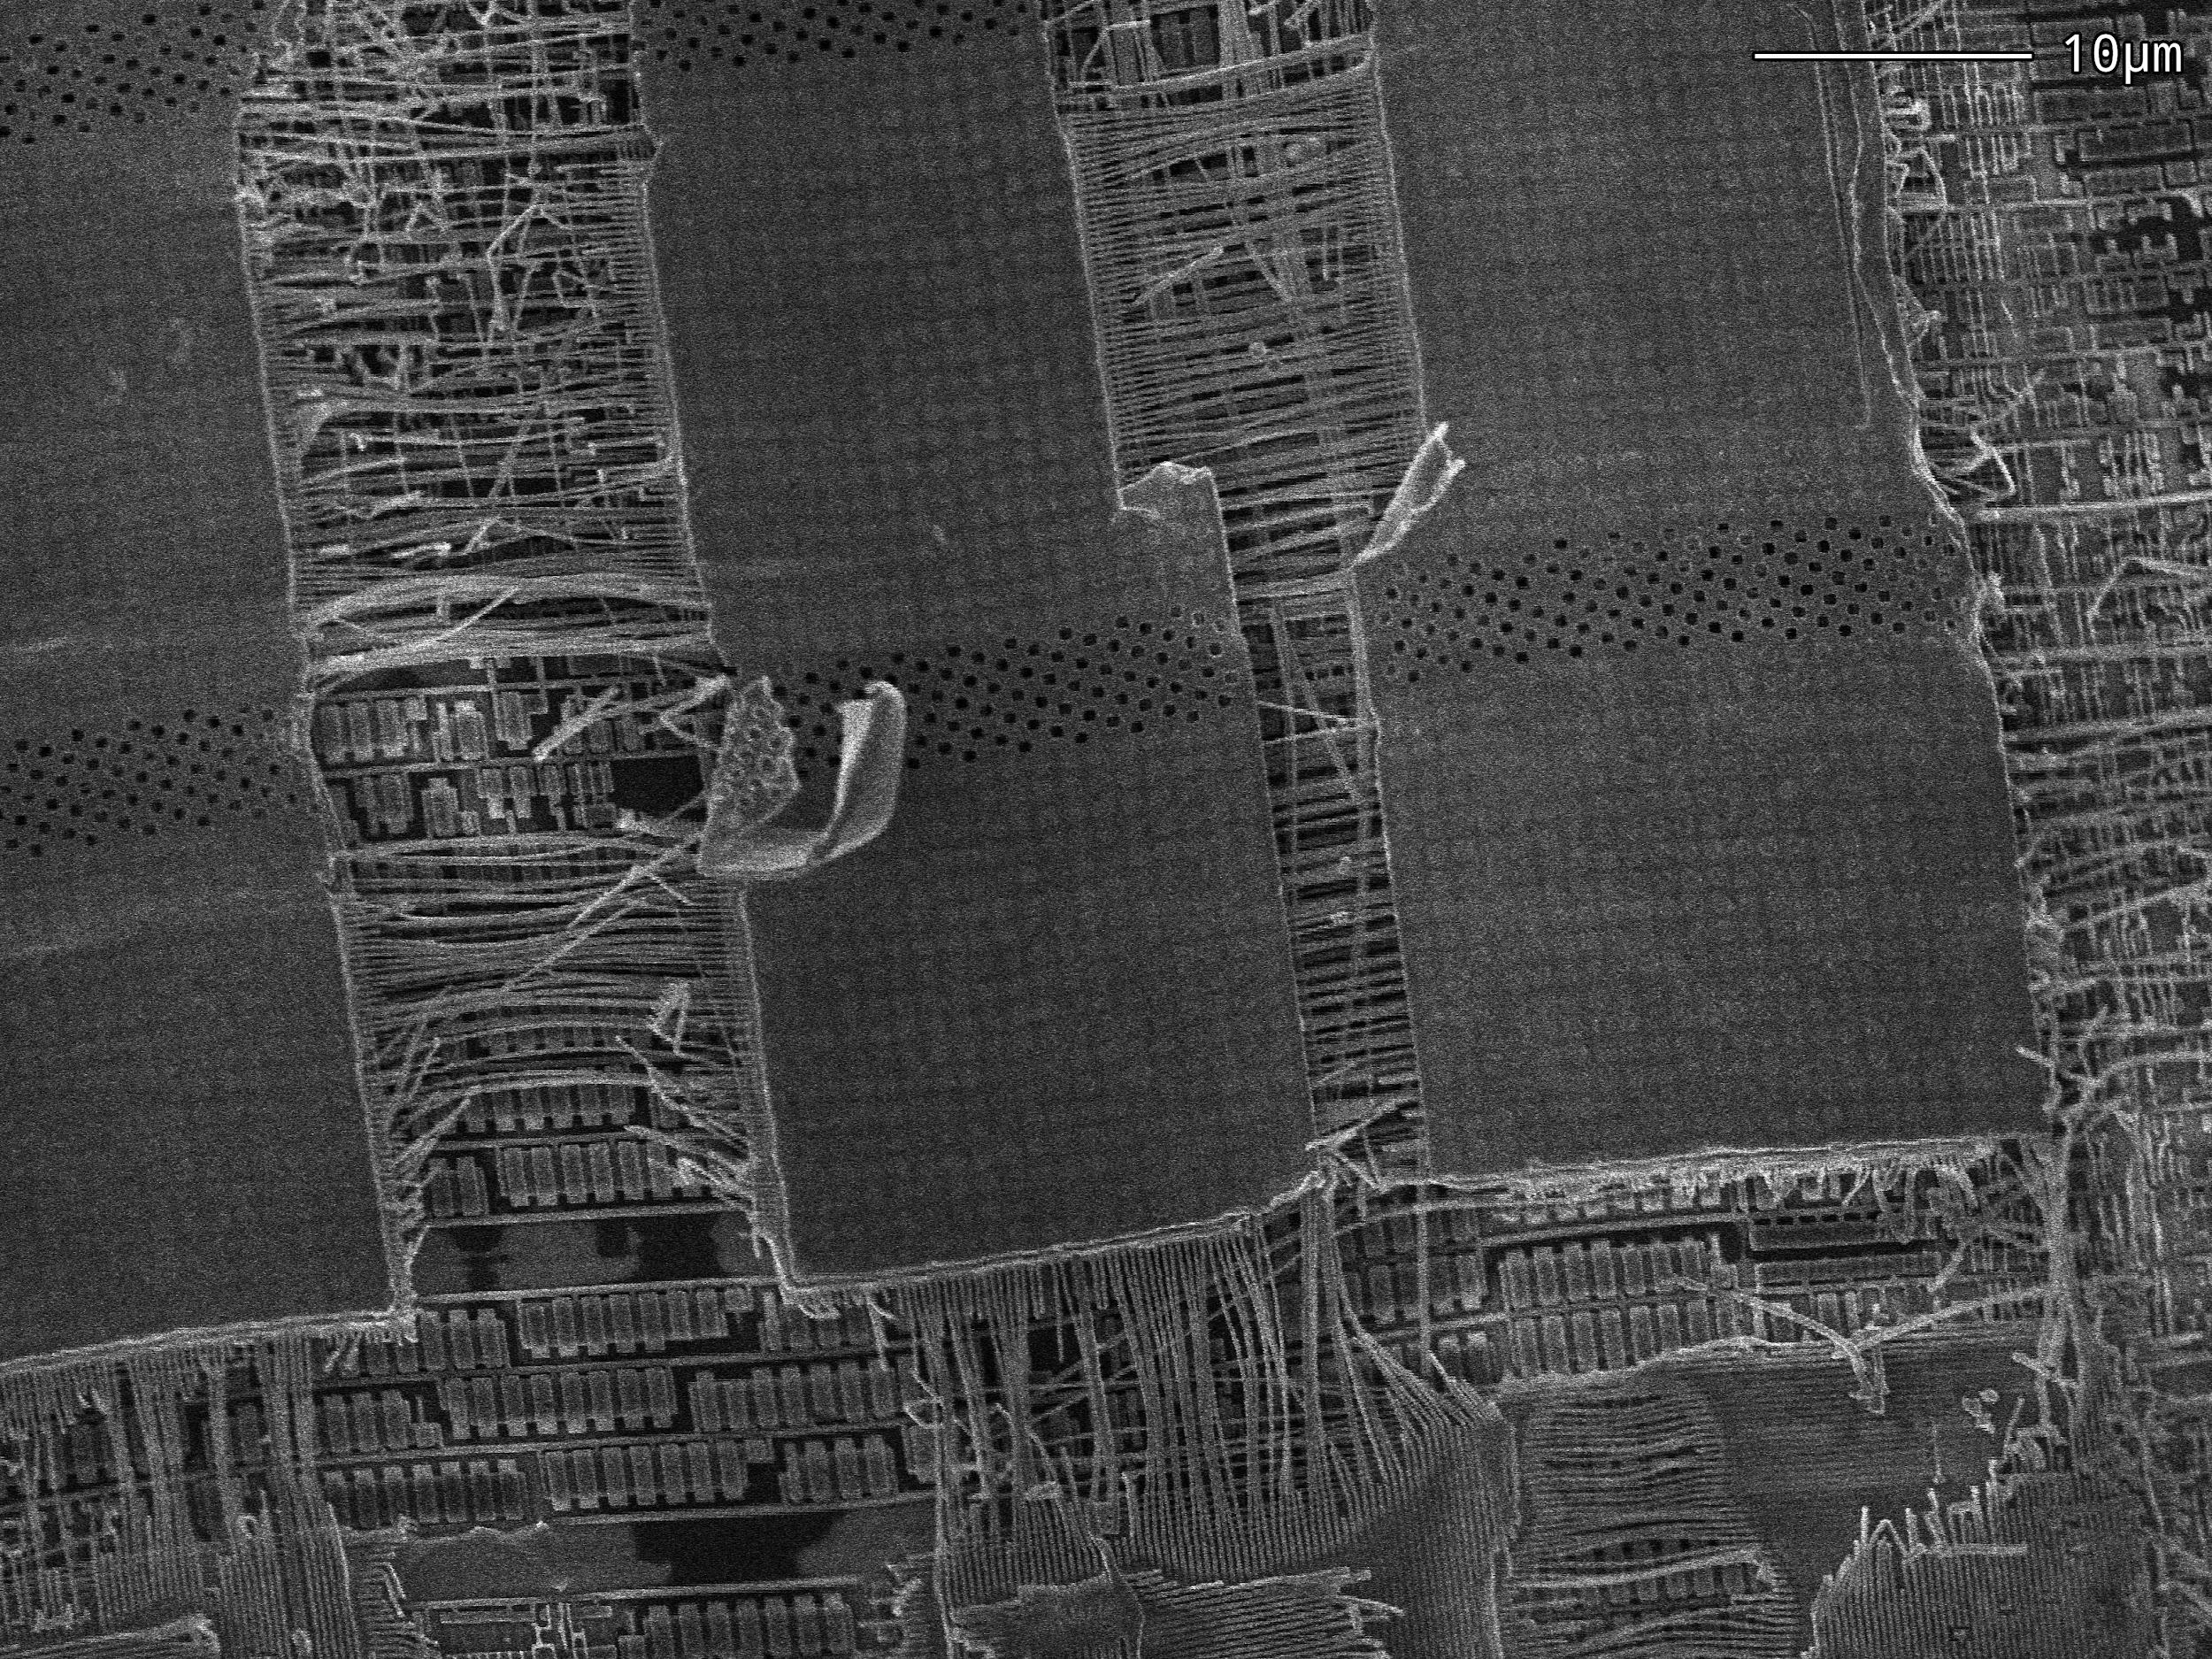
Notes:
Yubikey

Slide 31
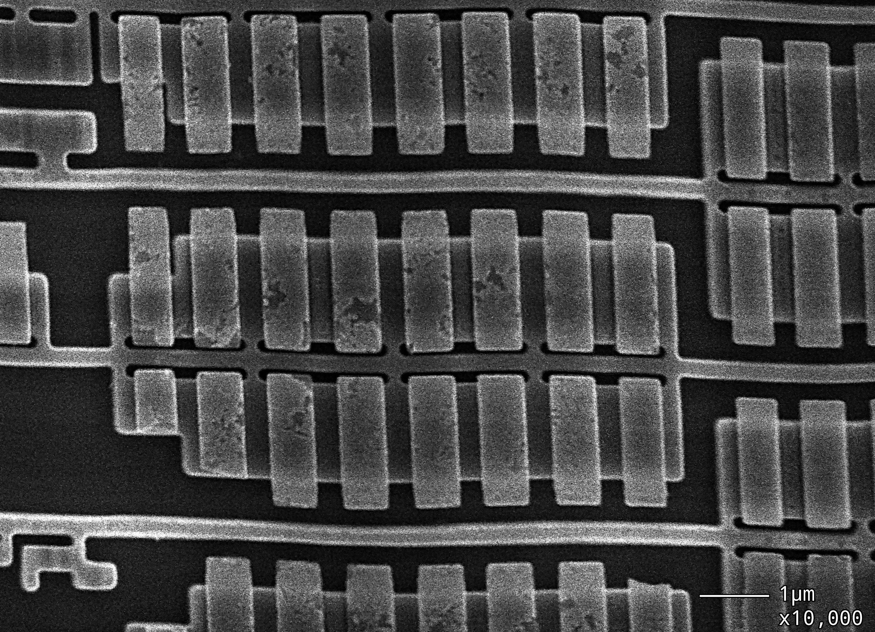

Slide 32
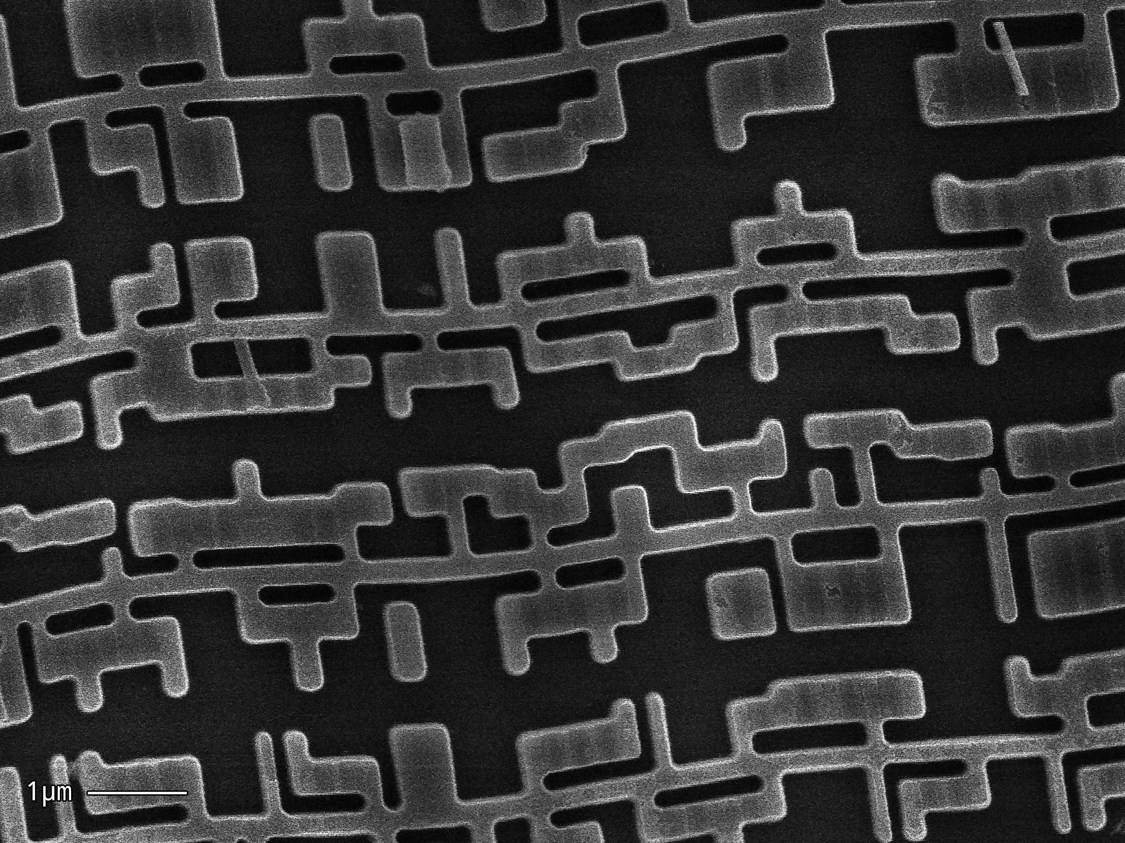

Slide 33
INSECT ALERT!

Slide 34
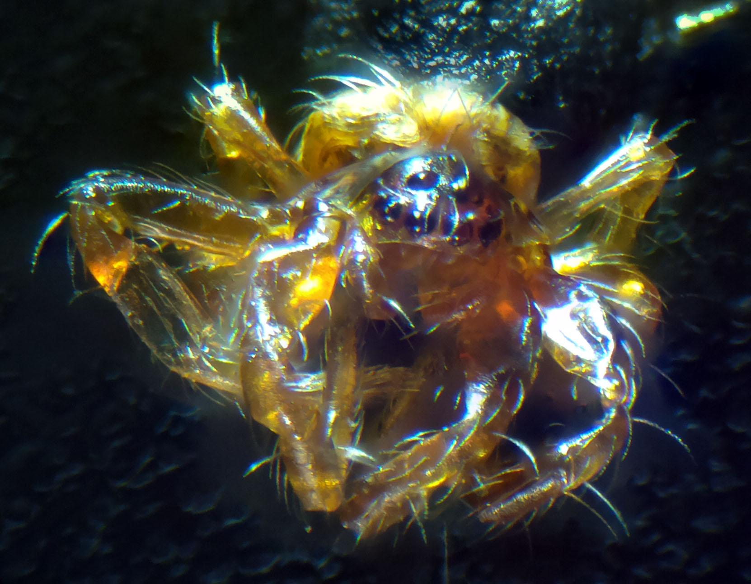

Slide 35
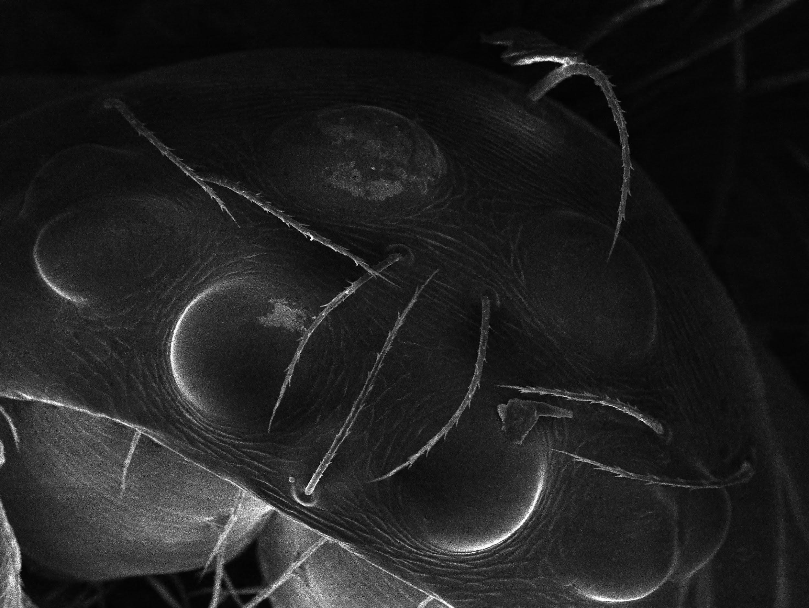

Slide 36
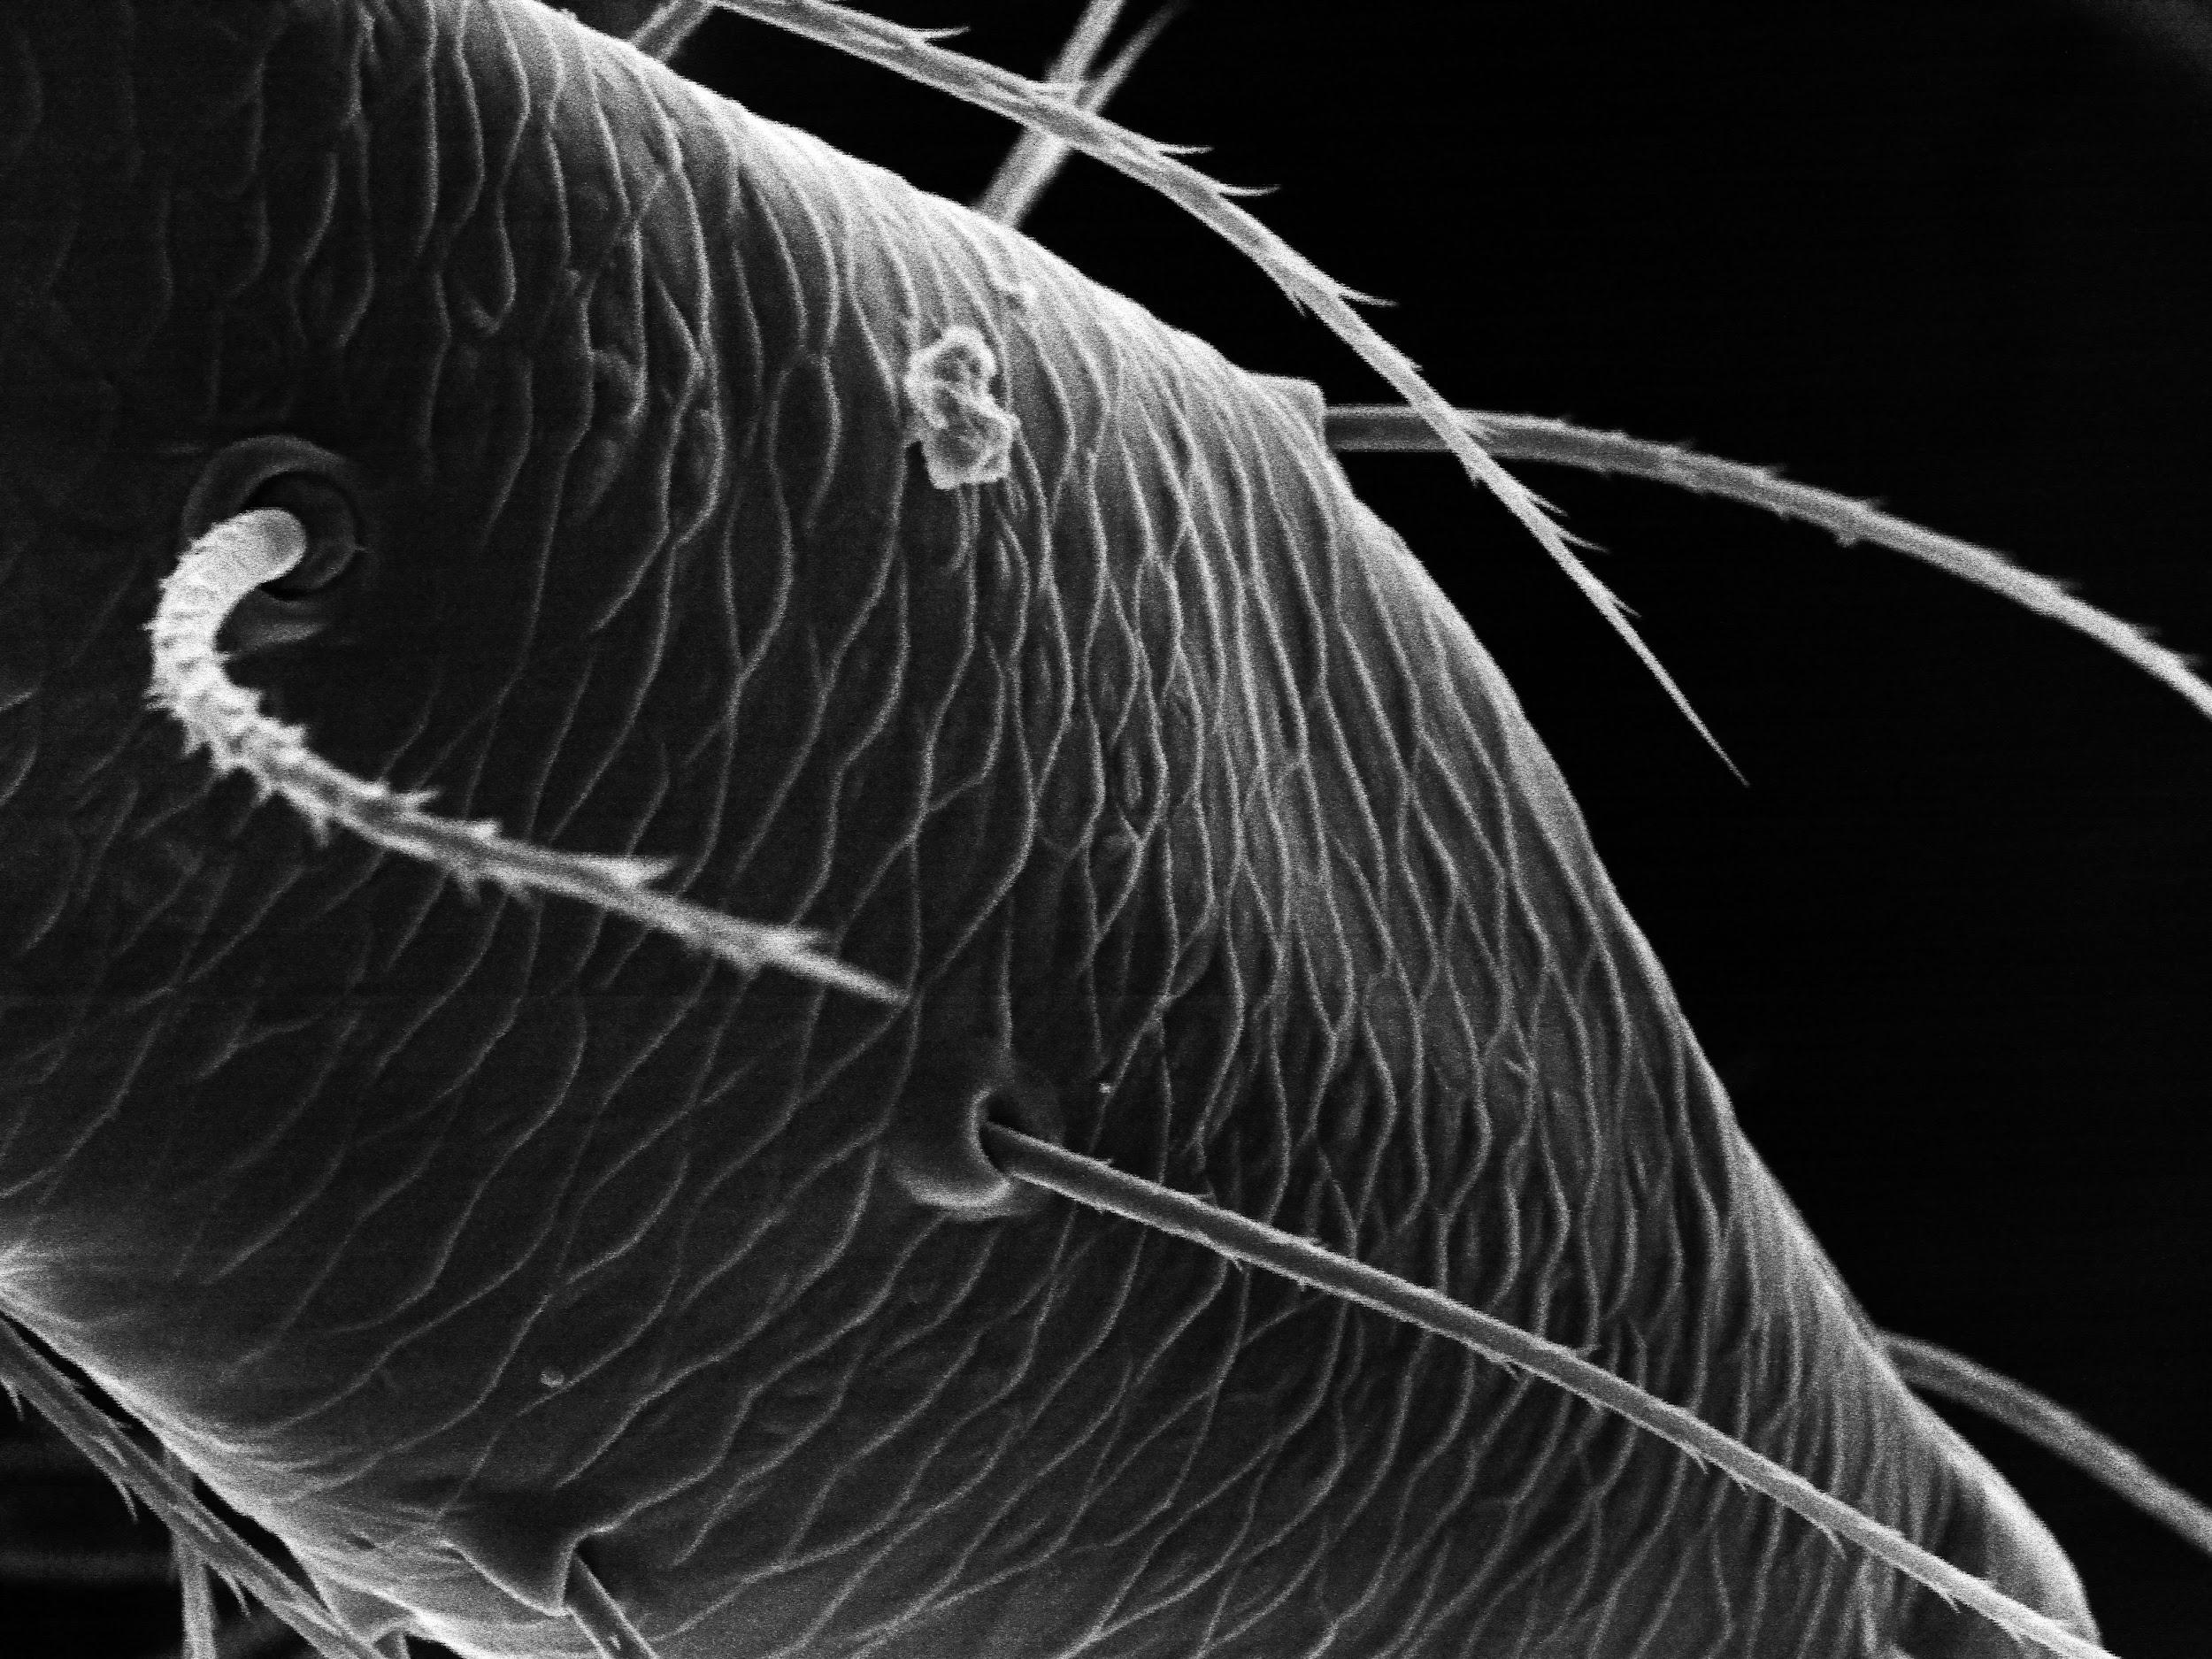

Slide 37
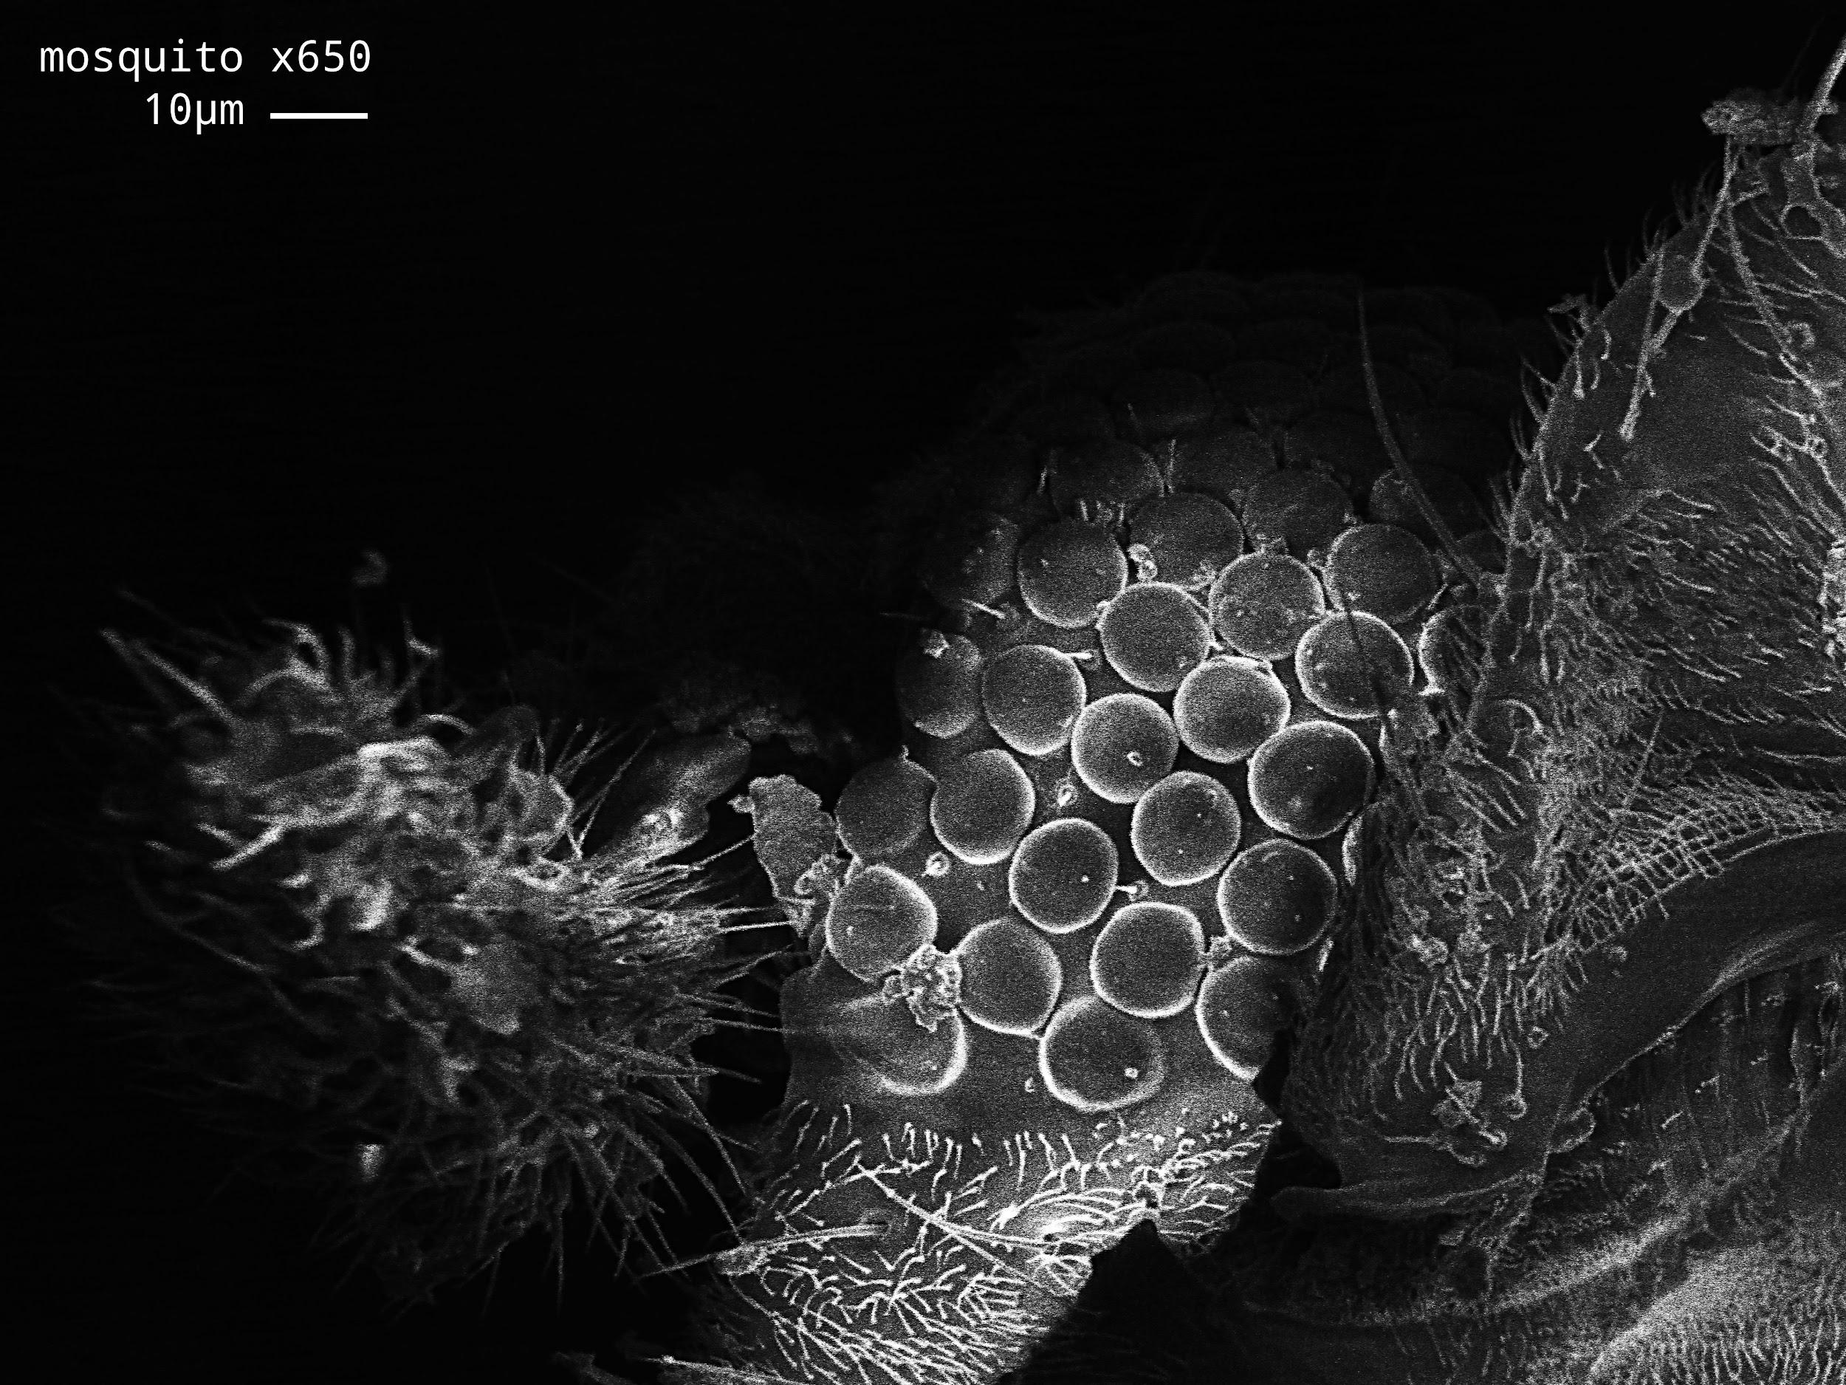

Slide 38
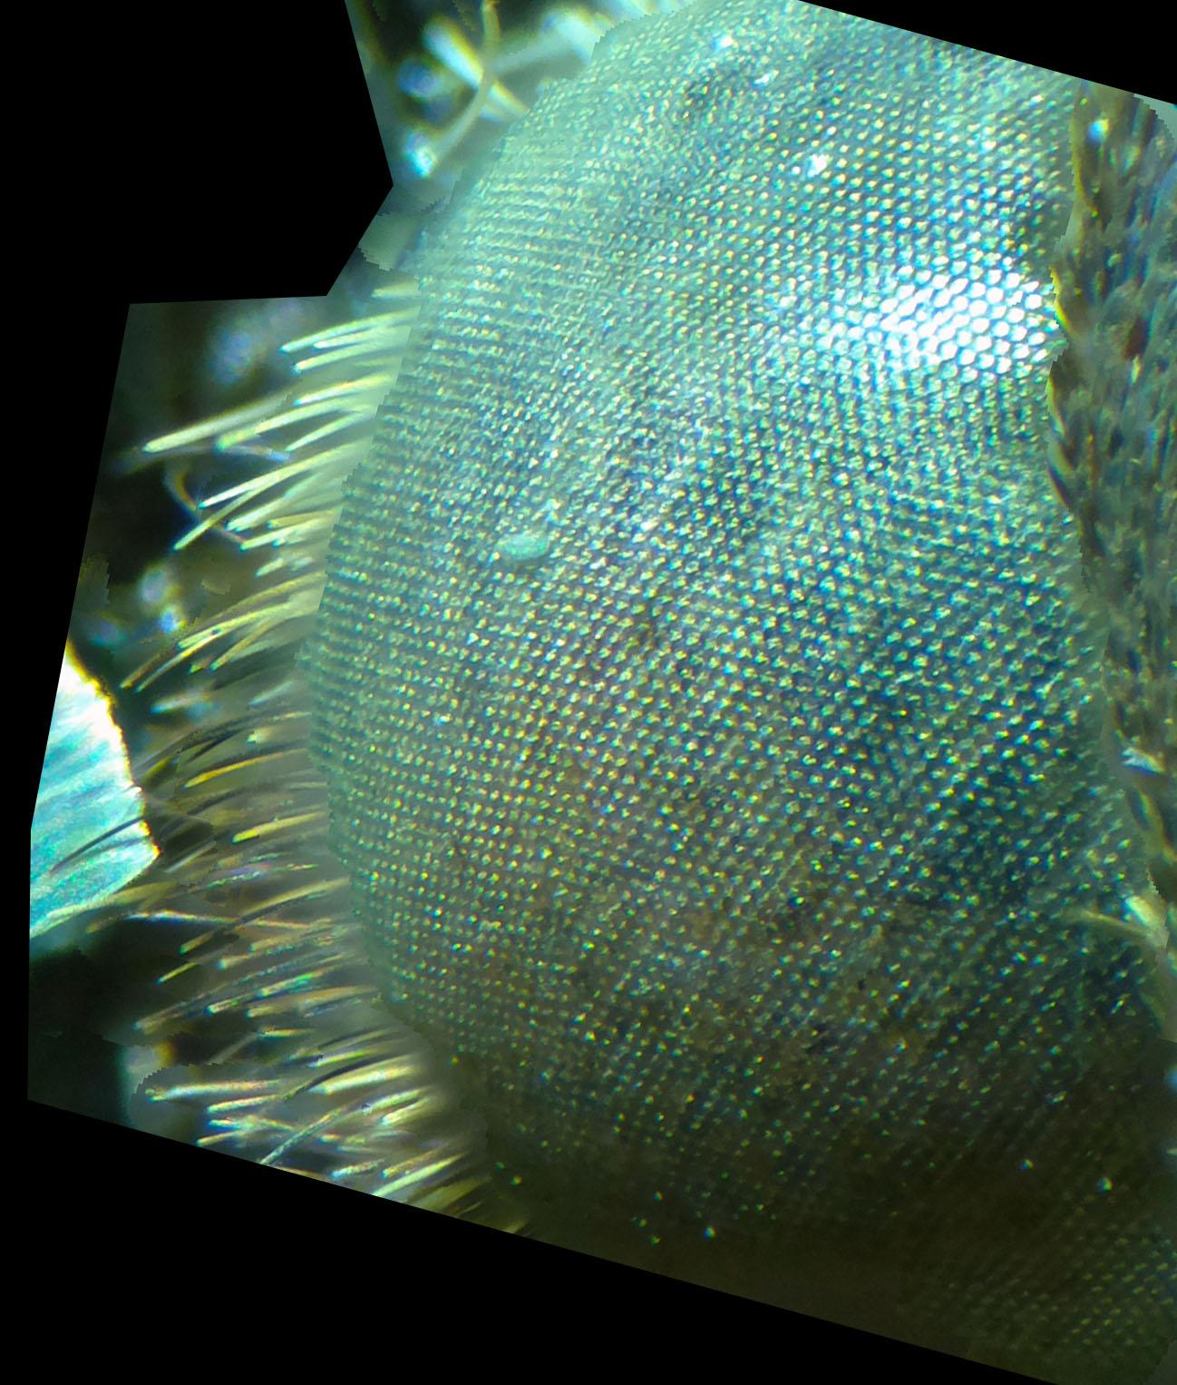

Slide 40
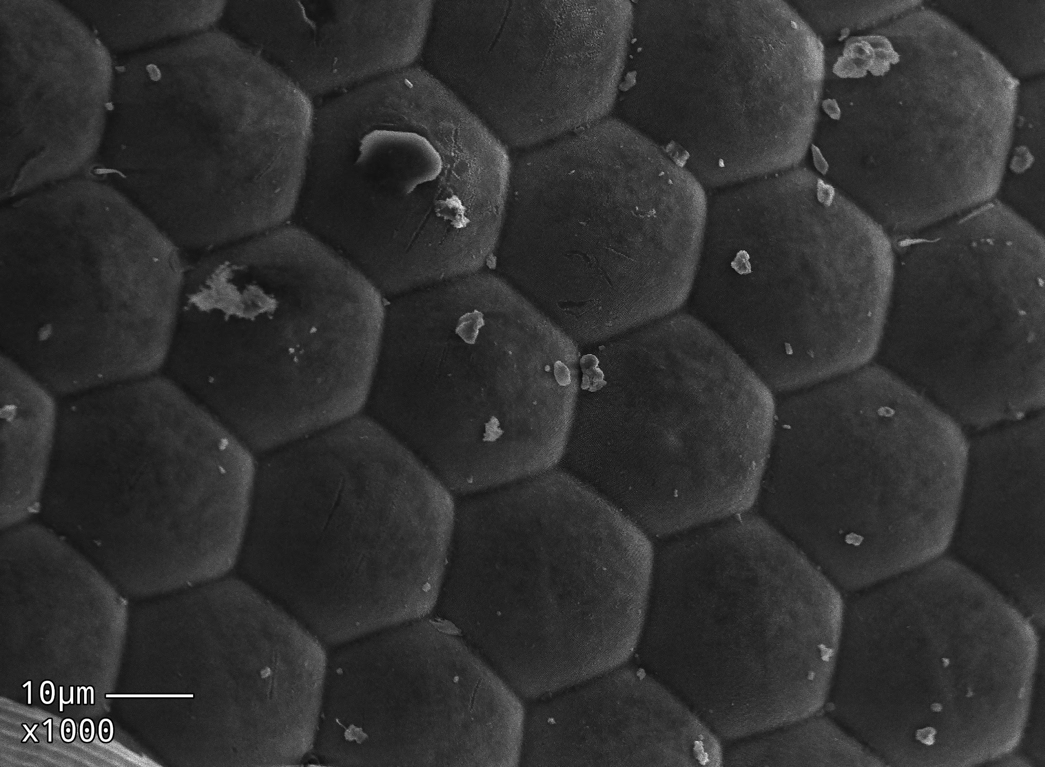

Slide 42
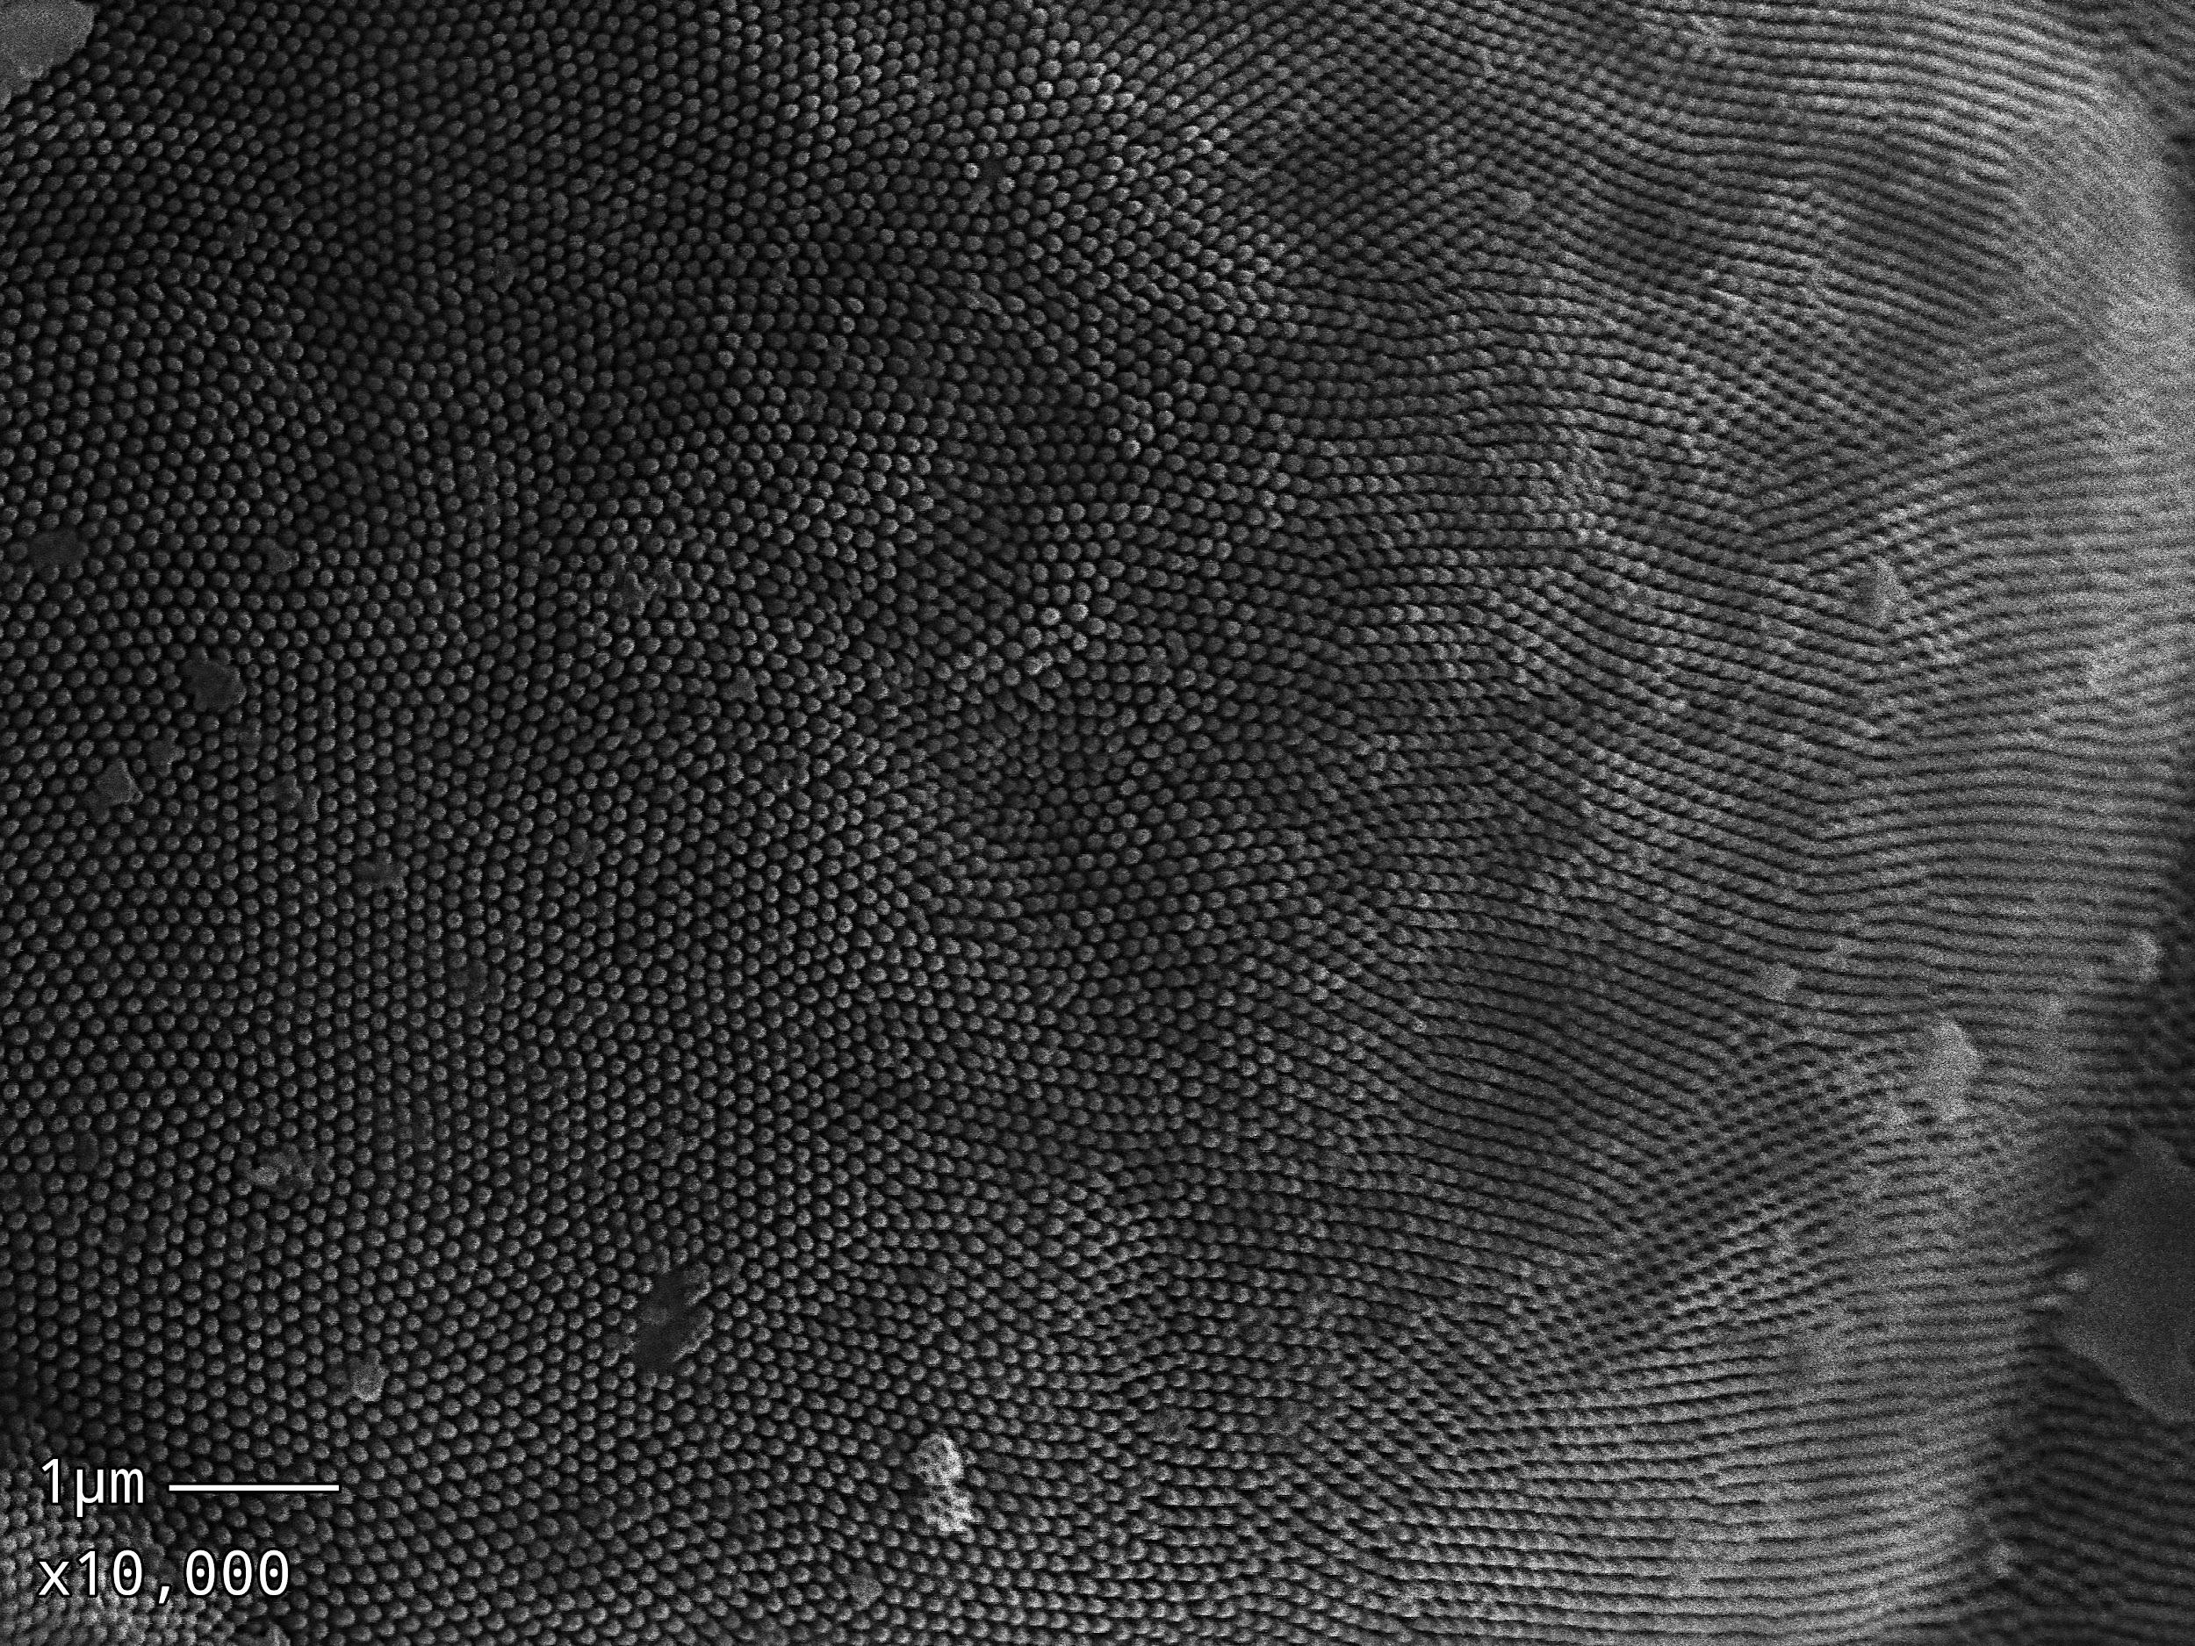

Slide 44
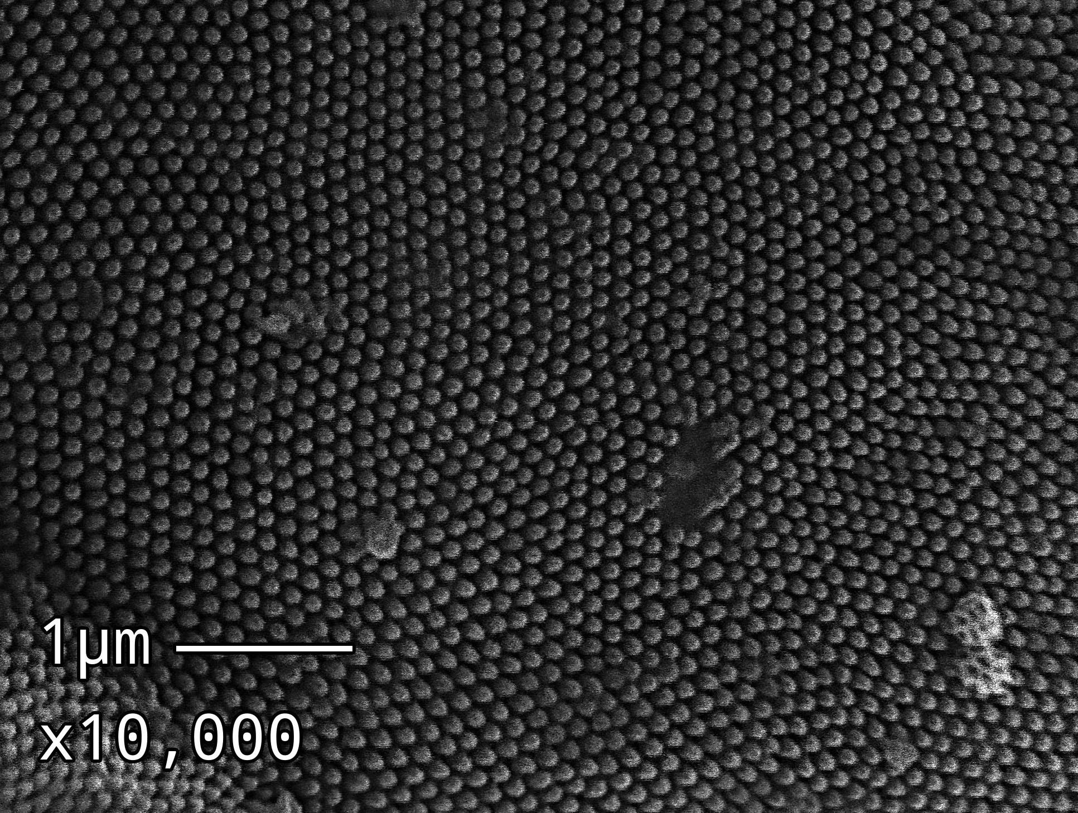

Slide 46
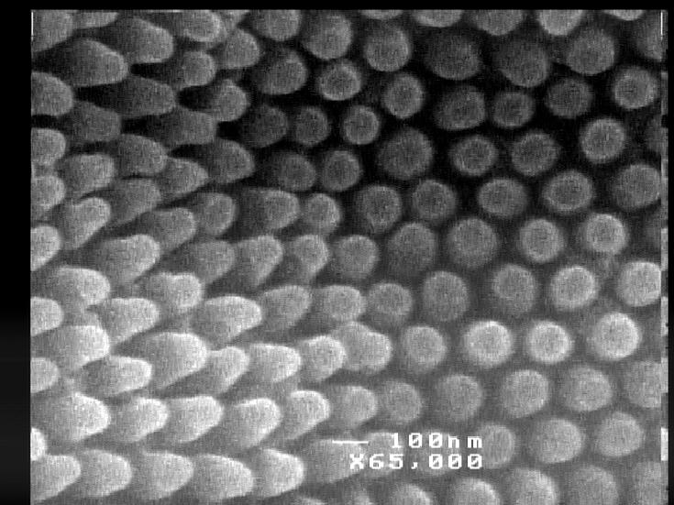

Slide 48
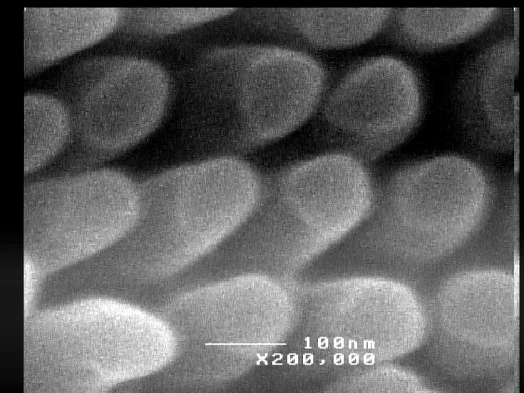

Slide 49
DNA: much deeper to go!
2nm diameter
0.34nm between bases

Slide 50
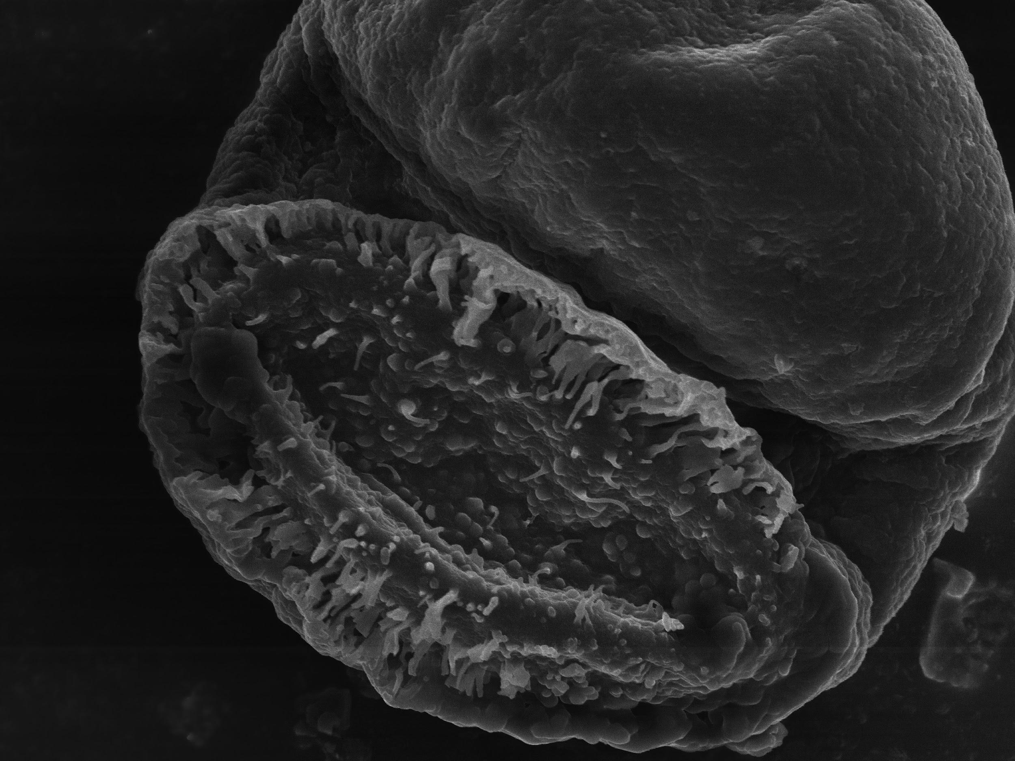

Slide 51
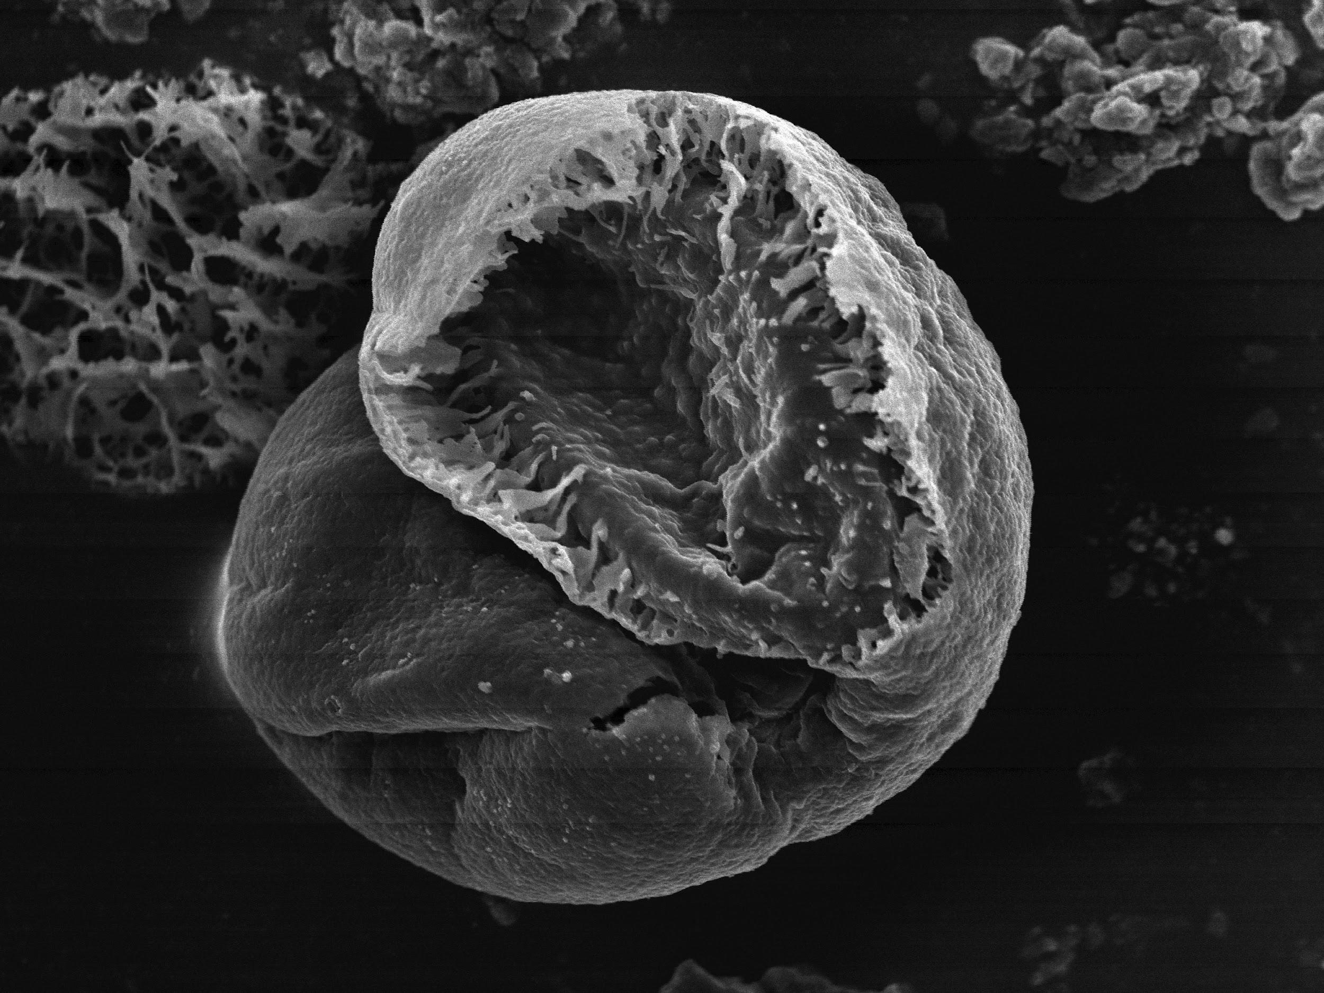

Slide 52
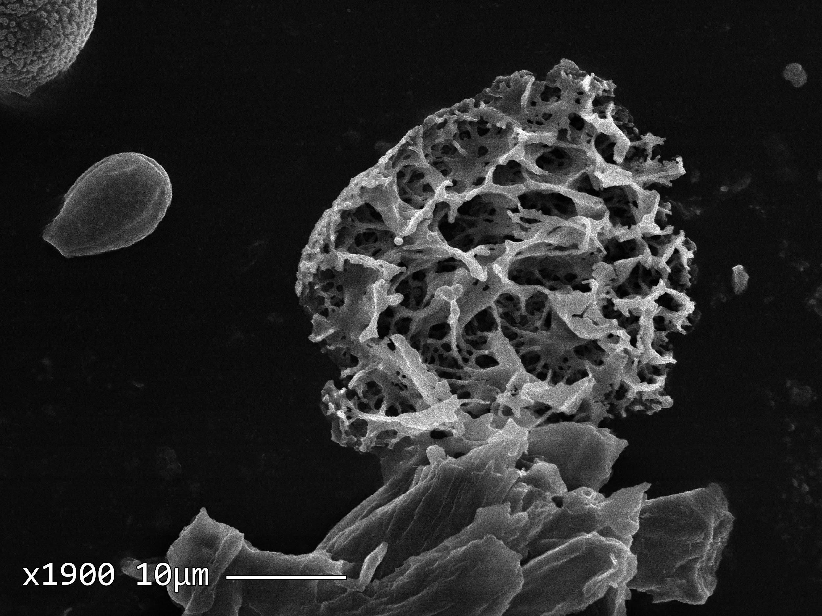

Slide 53
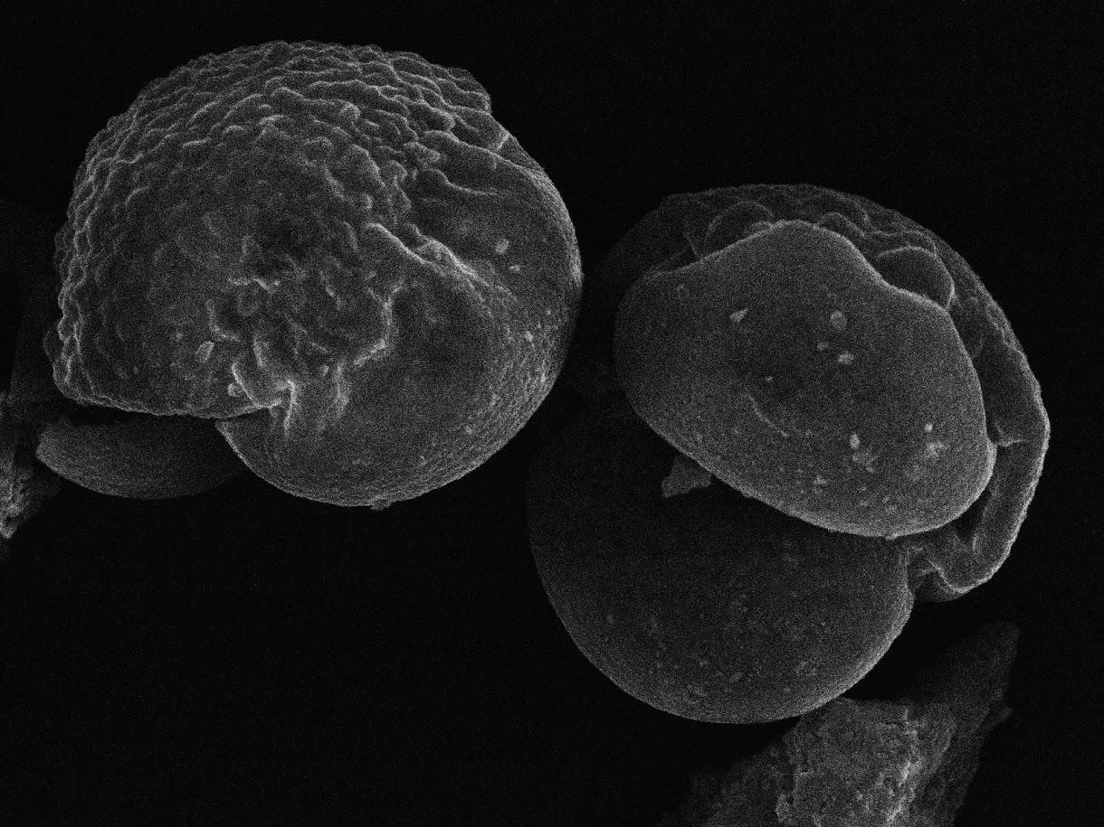
10µm pollen x2300

Slide 54
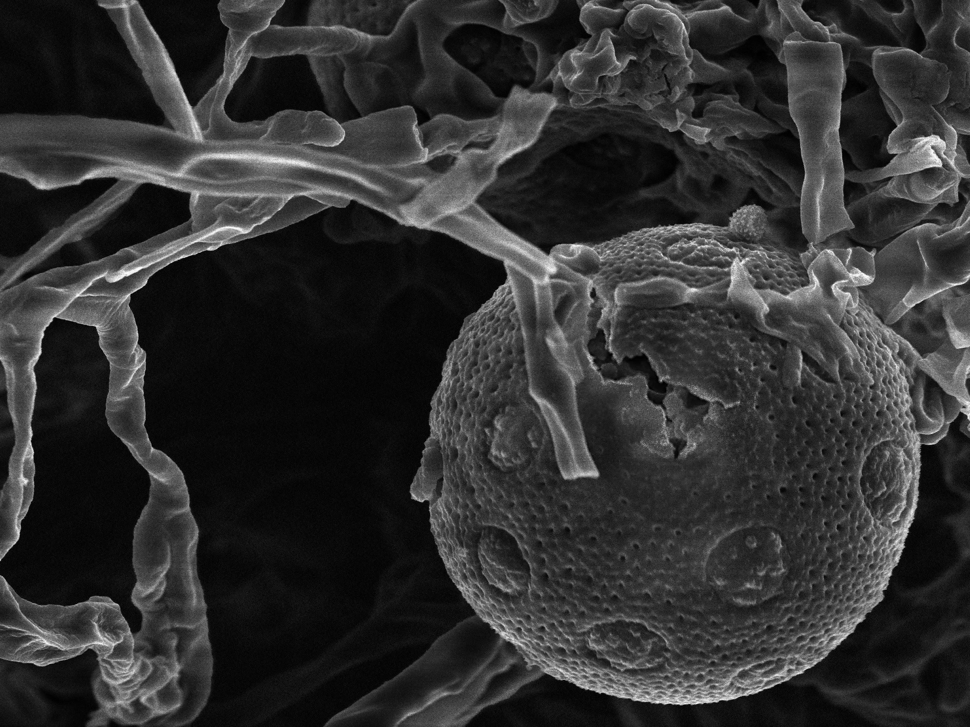

Slide 55
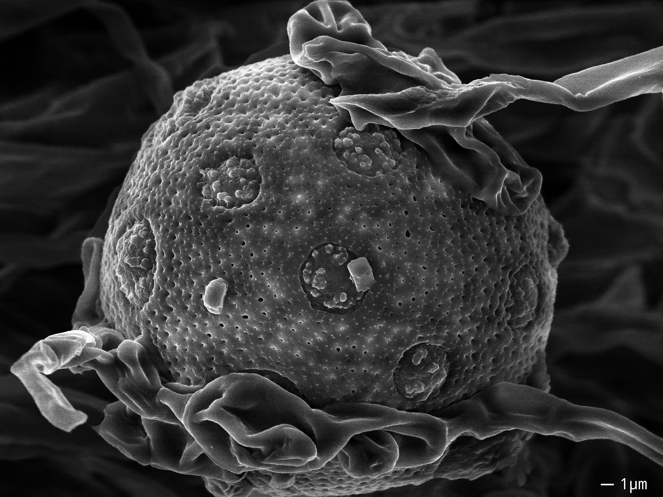

Slide 56
Rob Flickenger hackerfriendly.com

